Slide 1


Slide 2
PROCRASTINATION
"Even if you’re on the right track – you’ll get run over if you just sit there." – Arthur Godfrey, American radio broadcaster
"You cannot escape the responsibility of tomorrow by evading it today." – Abraham Lincoln
"My advice is to never do tomorrow what you can do today. Procrastination is the thief of time." – Charles Dickens.

Slide 3
Romans 12:2
“Do not conform to the pattern of this world but be transformed by the renewing of your mind. Then you will be able to test and approve what God’s will is—his good, pleasing and perfect will.” NIV.
“Don’t let the world around you squeeze you into its own mould…” J.B. Phillips.

Slide 4
ALL DRESSED UP!
Let us make choices with our eyes on heaven, not consumed by what the world says is right or important.
Colossians 3:1-2 NLT
”Since you have been raised to new life with Christ, set your sights on the realities of heaven, where Christ sits in the place of honour at God’s right hand.
Think about the things of heaven, not the things of earth.”

Slide 5
ALL DRESSED UP…IN THE WRONG THINGS!
Hebrews 12:1-2.
Therefore, since we are surrounded by such a huge crowd of witnesses to the life of faith, let us strip off every weight that slows us down, especially the sin that so easily trips us up. And let us run with endurance the race God has set before us. We do this by keeping our eyes on Jesus, the champion who initiates and perfects our faith. Because of the joy awaiting him, he endured the cross, disregarding its shame. Now he is seated in the place of honour beside God’s throne. Think of all the hostility he endured from sinful people; then you won’t become weary and give up. After all, you have not yet given your lives in your struggle against sin.”

Slide 6



So, we need to choose to take off:
Sexual immorality, impurity, lust, and evil desires.
Greed, for a greedy person is an idolater, worshipping the things of this world.
Anger, rage, malicious behaviour, revenge, slander,
unforgiveness and dirty language.
Don’t lie to each other; you have stripped off your old sinful nature and all its wicked deeds. (gossip, false witness…)

Slide 7
PUT ON YOUR NEW GARMENTS… Colossians 3:10, 12.“Put on your new nature, and be renewed as you learn to know your Creator and become like him. ¹¹ In this new life, it doesn’t matter if you are a Jew or a Gentile, circumcised or uncircumcised, barbaric, uncivilized, slave, or free. Christ is all that matters, and he lives in all of us.” ¹² Since God chose you to be the holy people he loves; you must clothe yourselves with…

Slide 8

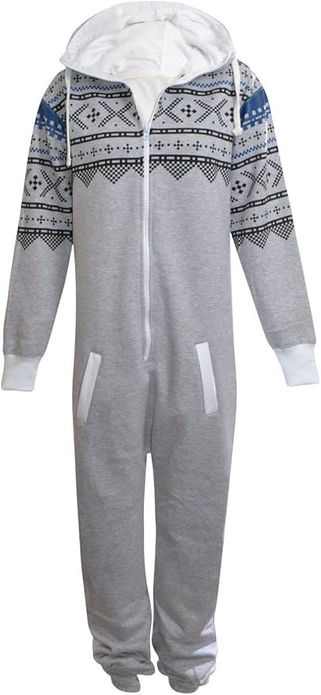
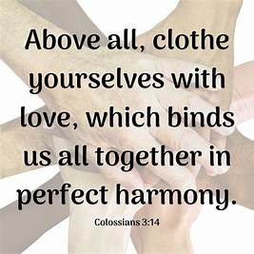
FORGIVENESS
LOVE
PEACE
THANKFULNESS

Slide 9

Colossians 3:17:” And whatever you do or say, do it as a representative of the Lord Jesus, giving thanks through him to God the Father.”

