Slide 1

Notes:
50k, now 40k - slower deployment, better figures and assumptions in the model, CP pipeline at the moment….
Over next 5 years - over 40k people impacted/ lives transformed through money coaching, finding freedom through having greater control of their money and finances, served by the local church.
‘It is really positive and encourages you to get on top of your money and get it in order, which gives you great freedom. It’s really changed us!’
The new resources have been updated with more faith content than before, giving coaches the opportunity to introduce why their faith makes a difference and offer prayer to participants interested.
1000 new churches connect with CAP over the next 5 years to train and run money coaching in their community - 1000 churches equipped to respond practically to the needs they see around them
At the end of 5 years, we expect our money coaching church network to have increased from c 580 to over 1000 churches
Penetration:
And our church penetration to have shifted from 2.6% today to 3.4% by 2028.
Those numbers assume flat network growth of our other service over the next 5 years with the increase coming from new money coaching churches. And to put that in perspective, if we take money coaching out of the equation, our penetration would be 1.3%
1.8% DC, JC & LS
2.6% current total penetration
3.4% by 2028
10% tipping point for movement building
And our church penetration to have shifted from 2.6% today to 3.4% by 2028.
Those numbers assume flat network growth of our other service over the next 5 years with the increase coming from new money coaching churches. And to put that in perspective, if we take money coaching out of the equation, our penetration would be 1.3%

Slide 2


Slide 3
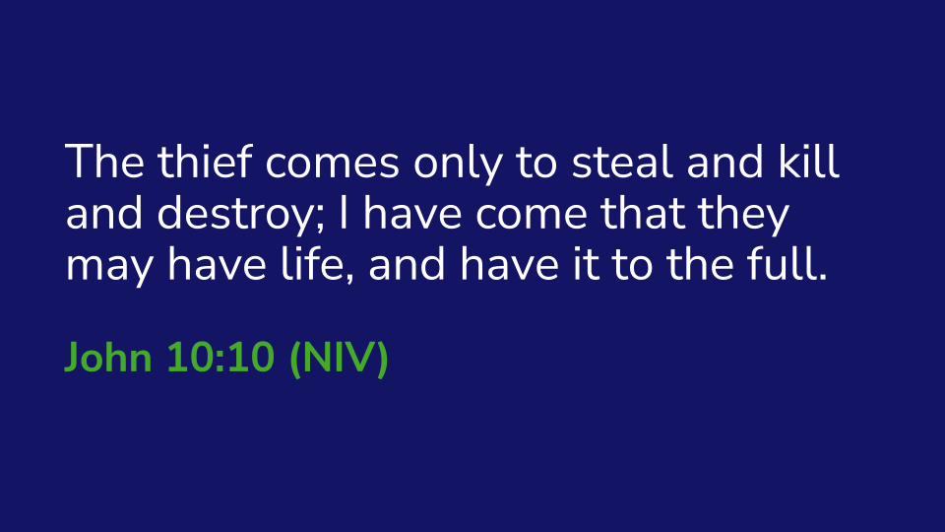

Slide 4
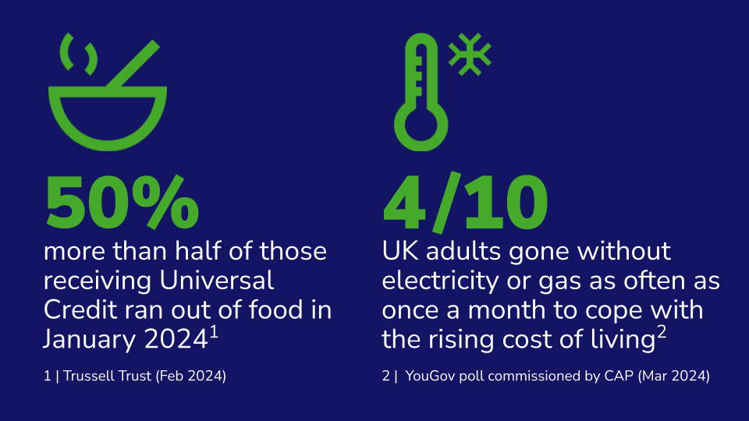

Slide 5
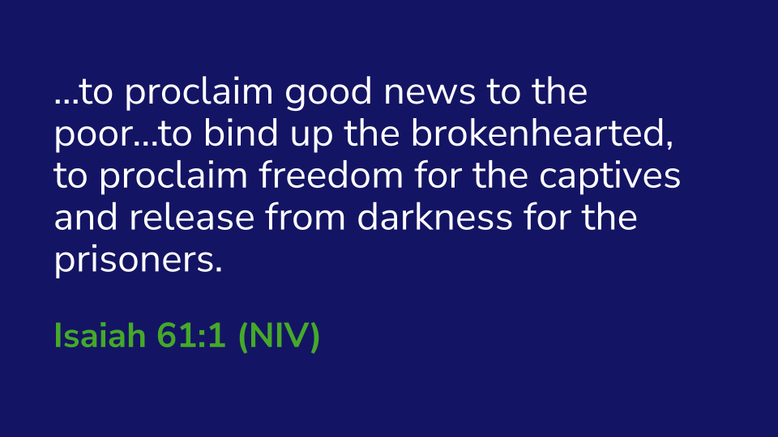

Slide 6


Slide 7


Slide 8


