Slide 1
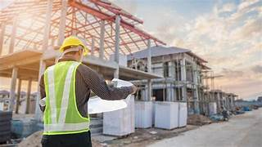
GOD:
THE MASTER BUILDER

Slide 2
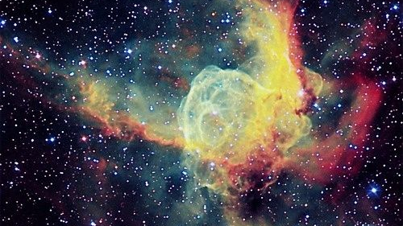

Slide 3
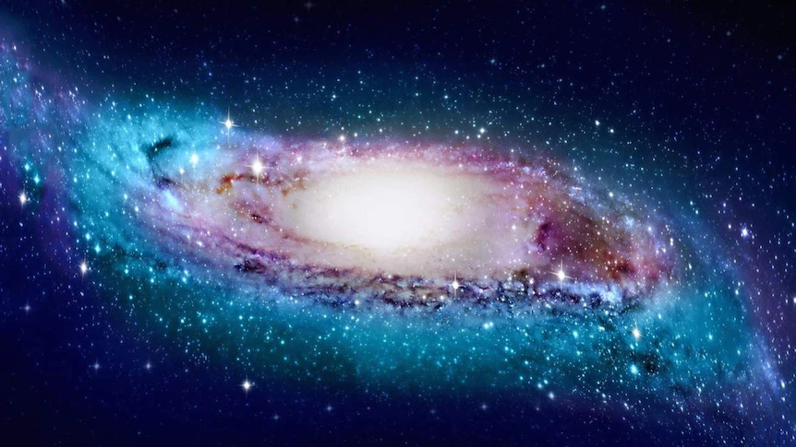

Slide 4
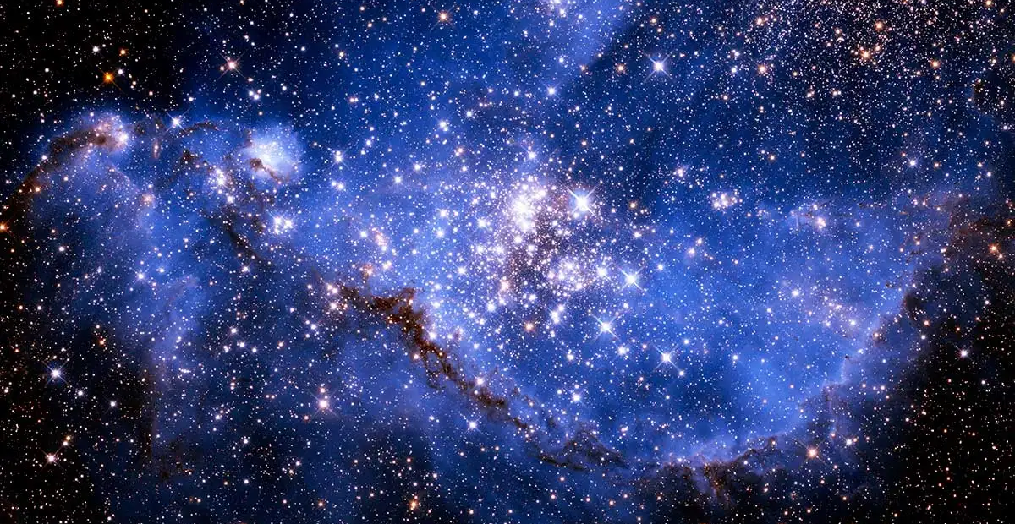

Slide 5
GOD THE MASTER BUILDER: THE CREATOR OF THE UNIVERSE
Hebrews 3:4: "For every house is built by someone, but God is the builder of all things." This highlights God's role as the ultimate architect and creator of the universe.
Psalm 19:1-2: “The heavens declare the glory of God; the skies proclaim the work of his hands. Day after day, they pour forth speech; night after night they reveal knowledge.” Psalm 8:3, Psalm 147:4, Isaiah 48:12-13.

Slide 6
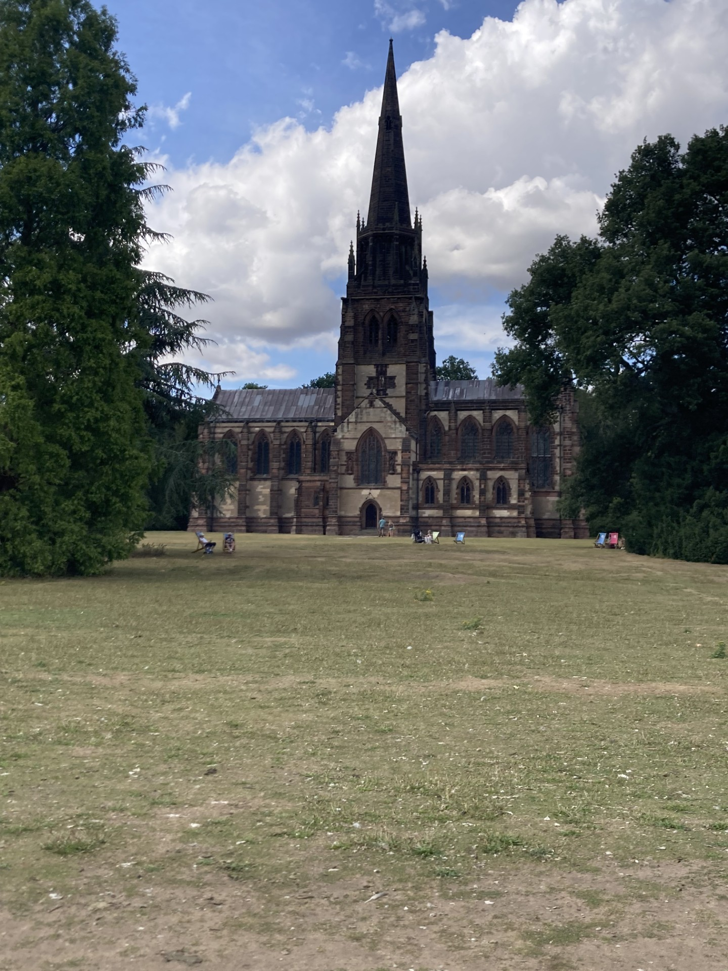
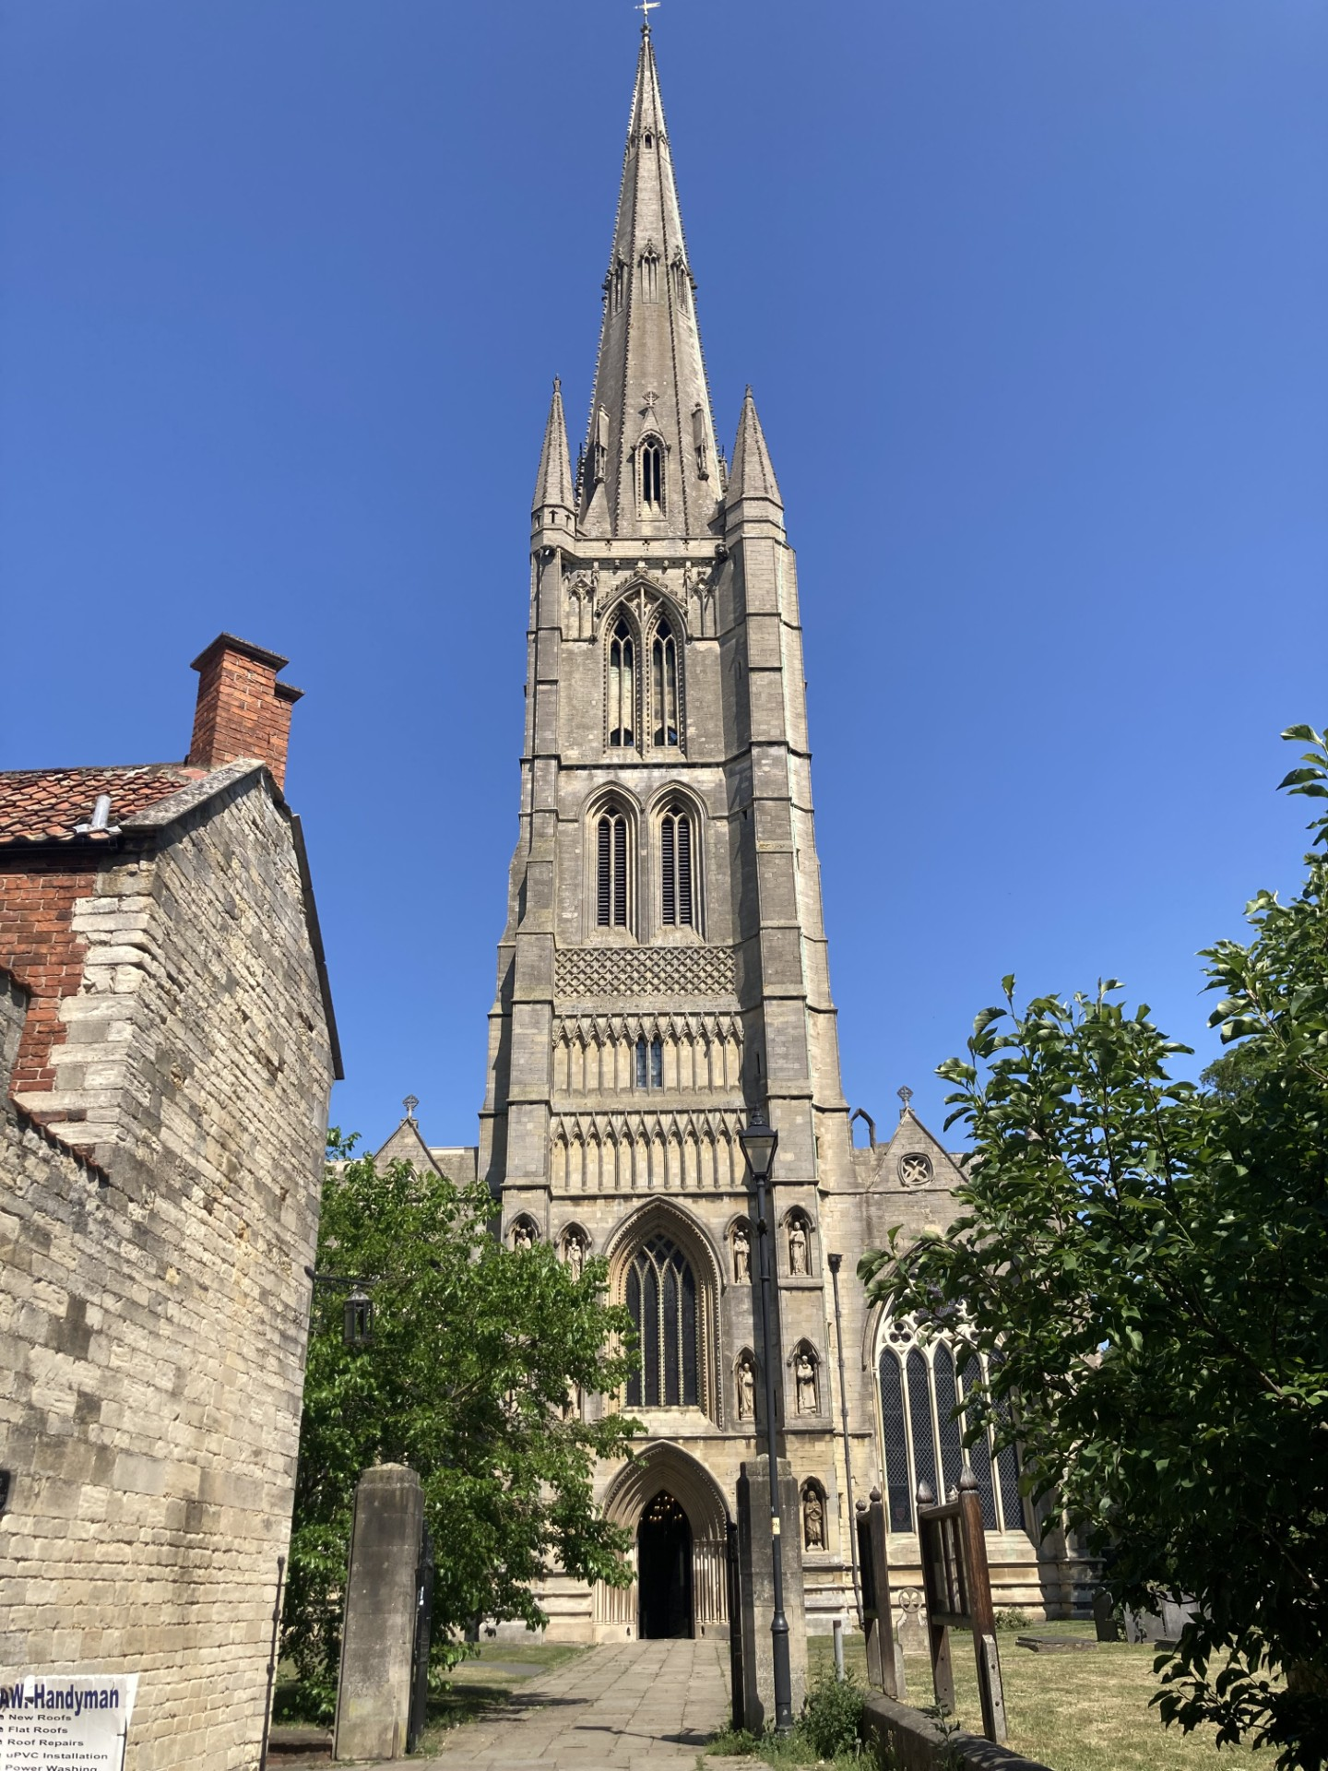

Slide 7

GOD BUILDING HIS KINGDOM
God is still building today: building His kingdom through the Church and through each of the individuals within it.
Psalm 127:1” Unless the Lord builds the house, the builders labour in vain.”
THE CHURCH The church, of course, is NOT the building, but the ecclesia, the gathering of God’s people.

Slide 8
The local church is the hope of the world
3 reasons why the church is the hope of the world:
1. We Carry the Truth of Christ.
2. We Are Called to Be Extensions of God's Love.
3. We Stand in the Gap in Intercession.
Psalm 127:1” Unless the Lord builds the house, the builders labour in vain.”

Slide 9
EACH LIVING STONE
Within His plan for building His kingdom here on earth, God has a blueprint for each of our lives. Jeremiah 29:11.
1 Peter 2:4–5
The Living Stone and a Chosen People
As you come to him, the living Stone—rejected by humans but chosen by God and precious to him—you also, like living stones, are being built into a spiritual house to be a holy priesthood, offering spiritual sacrifices acceptable to God through Jesus Christ.

Slide 10
GOD:
THE MASTER BUILDER
Is He the Master Builder
in your life? And the life of this church?

