Slide 1

Galatians 5:22-26

Slide 2
But the fruit of the Spirit
is love, joy, peace,
forbearance, kindness,
goodness, faithfulness,
gentleness and self-control.
Against such things there is no law.
Those who belong to Christ Jesus have crucified
the flesh with its passions and desires. ²⁵
Since we live by the Spirit, let us keep in step with the
Spirit. ²⁶ Let us not become conceited, provoking and
envying each other. (Galatians 5:22-26)

Slide 3
What good things
will you remember
here today?
‘Let all that I am praise the Lord; may I never forget the good things he does for me.’ (Psalm 103:2)

Slide 4
Determine to HEAR and
ACT on his word
TODAY!
’Therefore everyone who hears these words of mine and puts them into practice is like a wise man who built his house on the rock.’ (Matthew 7:24)

Slide 5
It’s all about him
The importance of the Spirit
The fruit - him in me

Slide 6
It’s ALL about HIM.
I have been crucified with Christ and I no longer live, but Christ lives in me. The life I now live in the body, I live by faith in the Son of God, who loved me and gave himself for me. (Galatians 2:20)

Slide 7
It’s ALL about HIM.
I would like to learn just one thing from you: did you receive the Spirit by the works of the law, or by believing what you heard? (Galatians 3:2)

Slide 8
It’s ALL about HIM.
So in Christ Jesus you are all children of God through faith, for all of you who were baptised into Christ have clothed yourselves with Christ. There is neither Jew nor Gentile, neither slave nor free, nor is there male and female, for you are all one in Christ Jesus. If you belong to Christ, then you are Abraham’s seed, and heirs according to the promise. (Galatians 3:26-29)

Slide 9
The importance of the Spirit
Because you are his sons, God sent the Spirit of his Son into our hearts, the Spirit who calls out, ‘Abba, Father.’ ⁷ So you are no longer a slave, but God’s child; and since you are his child, God has made you also an heir. (Galatians 4:6-7)

Slide 10
The importance of the Spirit
For through the Spirit we eagerly await by faith the righteousness for which we hope. ⁶ For in Christ Jesus neither circumcision nor uncircumcision has any value. The only thing that counts is faith expressing itself through love. (Galatians 5:5-6)

Slide 11
The fruit – HIM in me
You, my brothers and sisters, were called to be free. But do not use your freedom to indulge the flesh; rather, serve one another humbly in love. ¹⁴ For the entire law is fulfilled in keeping this one command: “Love your neighbour as yourself.” ¹⁵ If you bite and devour each other, watch out or you will be destroyed by each other. (Galatians 5:13-15)

Slide 12
The fruit – HIM in me
Love is patient, love is kind. It does not envy, it does not boast, it is not proud. ⁵ It does not dishonour others, it is not self-seeking, it is not easily angered, it keeps no record of wrongs. ⁶ Love does not delight in evil but rejoices with the truth. ⁷ It always protects, always trusts, always hopes, always perseveres. ⁸ Love never fails…. And now these three remain: faith, hope and love. But the greatest of these is love. (1 Cor. 13:4-8,13)

Slide 13
The fruit – HIM in me
As a prisoner for the Lord, then, I urge you to live a life worthy of the calling you have received. ² Be completely humble and gentle; be patient, bearing with one another in love. ³ Make every effort to keep the unity of the Spirit through the bond of peace. (Ephesians 3:1-3)

Slide 14
CONCLUSION:
It’s ALL about HIM – Thank and praise Him
The importance of the SPIRIT – Welcome Him
The FRUIT – HIM in me – Respond to Him in you

Slide 15
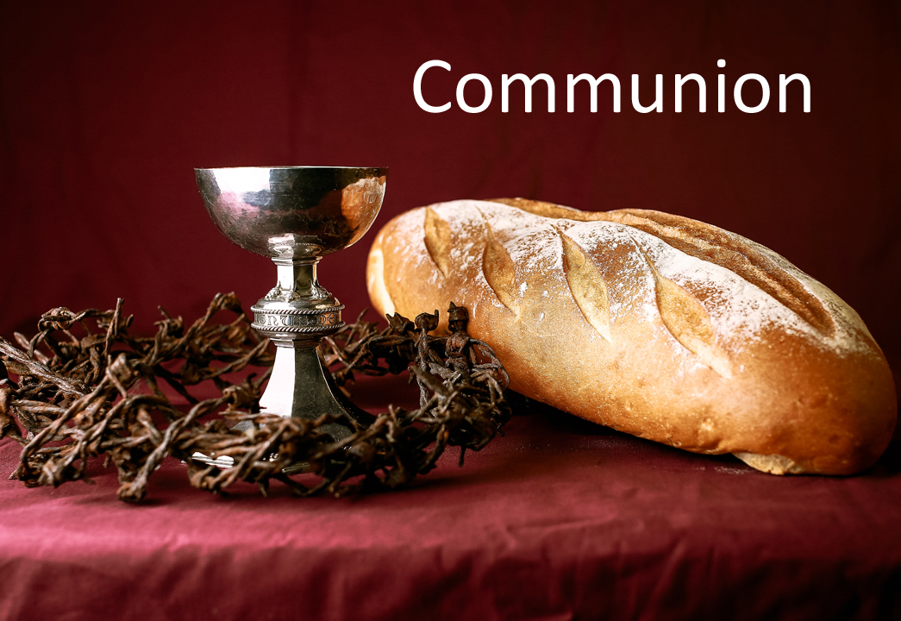

Slide 16
Confession:
Almighty God,
to whom all hearts are open,
all desires known,
and from whom no secrets are hidden:
cleanse the thoughts of our hearts
by the inspiration of your Holy Spirit,
that we may perfectly love you,
and worthily magnify your holy name;
through Christ our Lord. Amen.

Slide 17
Loving God, we praise and thank you for your love shown to us in Jesus Christ.
We thank you for his life and ministry, announcing the good news of your kingdom and demonstrating its power
in the lifting of the downtrodden, and the healing of the sick, and the loving of the loveless.

Slide 18
We thank you for his sacrificial death upon the cross for the redemption of the world, and for your raising him to life again, as a foretaste of the glory we shall share.
We give you thanks for this bread and wine, symbols of our world and signs of your transforming love.
Send your Holy Spirit, we pray, that we may be renewed into the likeness of Jesus Christ and formed into his Body.
This we pray in his name and for his sake. Amen.

Slide 19
