Slide 2


Slide 3
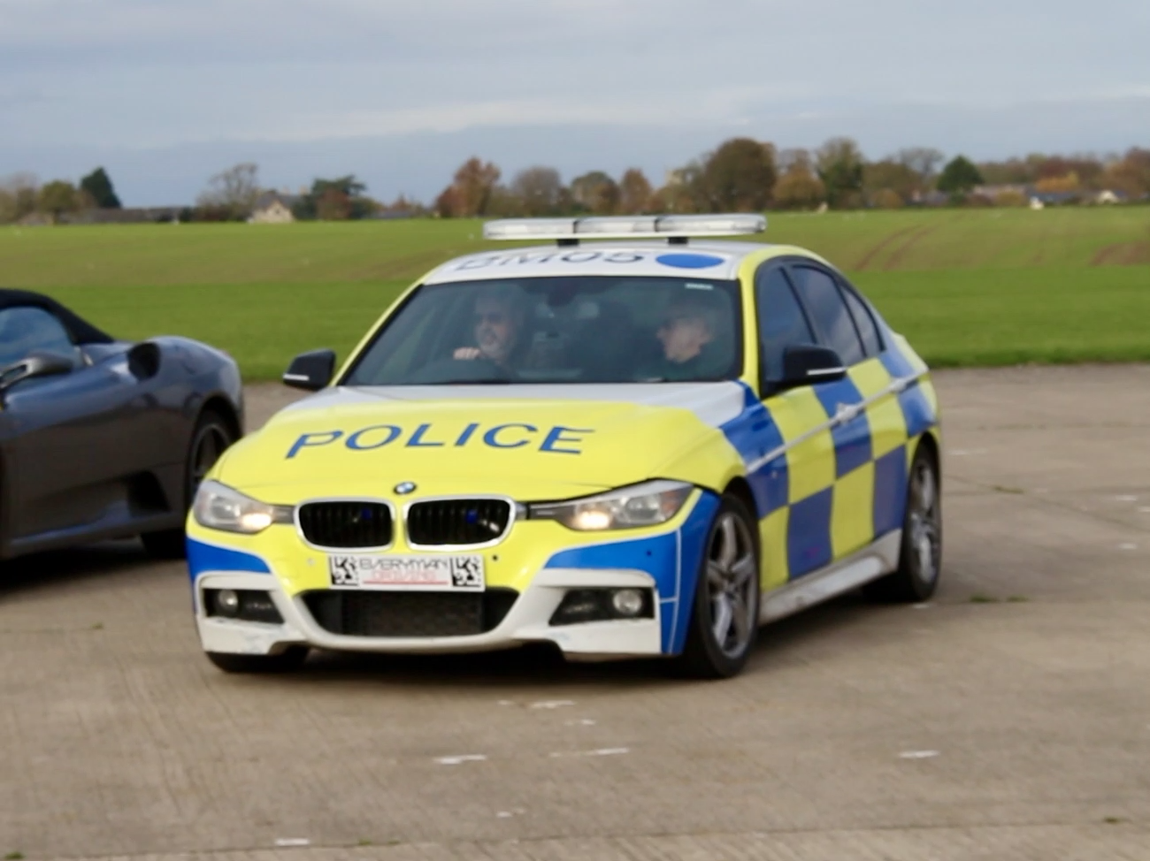

Slide 4
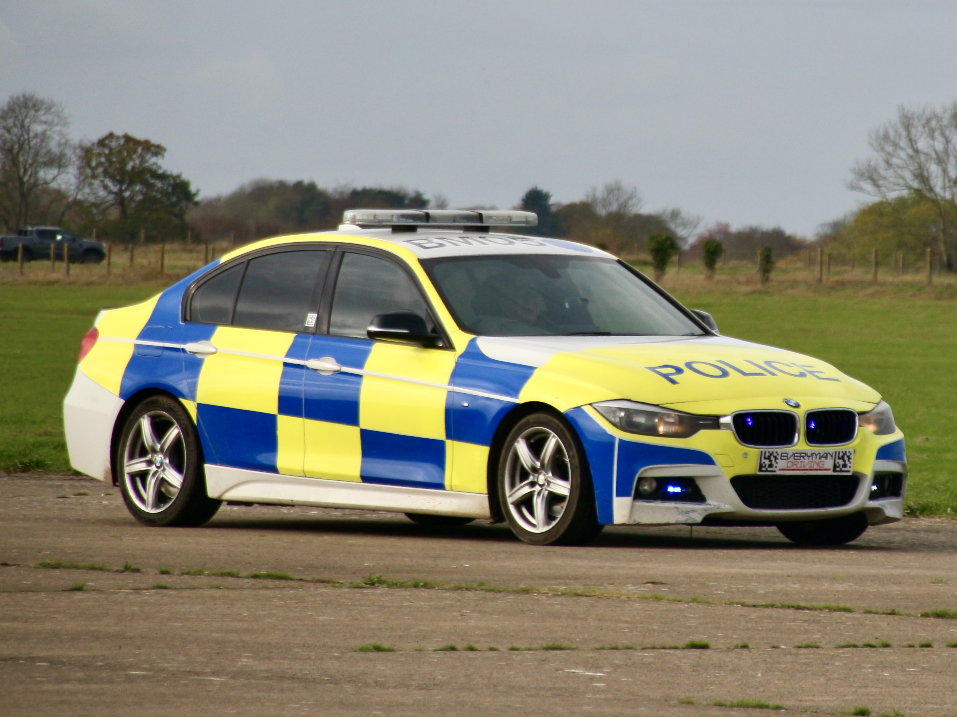

Slide 5

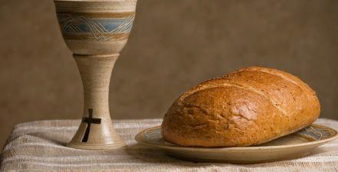
we wear these to remember them
we do this to remember Him

Slide 6
JOHN 7:53-8:11
Then they all went home, but Jesus went to the Mount of Olives.
At dawn He appeared again in the temple courts, where all the people gathered around Him, and He sat down to teach them. The teachers of the law and the Pharisees brought in a woman caught in adultery and made her stand before the group and said to Jesus,

Slide 7
JOHN 7:53-8:11
"Teacher, this woman was caught in the act of adultery. In the Law, Moses commanded us to stone such women. Now what do you say?”
They were using the question as a trap, in order to have a basis for accusing Him.
But Jesus bent down and started to write on the ground with His finger.

Slide 8
JOHN 7:53-8:11
When they kept on questioning Him, He straightened up and said to them, “If any one of you is without sin, let him be the first to throw a stone at her."
Again He stooped down and wrote on the ground. At this, those who heard began to go away one at a time, the older ones first, until only Jesus was left with the woman still standing there.

Slide 9
JOHN 7:53-8:11
Jesus straightened up and asked her, "Woman, where are they? Has no one condemned you?" 'No one, sir," she said. "Then neither do I condemn you,” Jesus declared.
"Go now and leave your life of sin."

Slide 10
JOHN 8:2-5
At dawn He appeared again in the temple courts, where all the people gathered around Him, and He sat down to teach them. The teachers of the law and the Pharisees brought in a woman caught in adultery and made her stand before the group and said to Jesus, "Teacher, this woman was caught in the act of adultery. In the Law, Moses commanded us to stone such women. Now what do you say?"

Slide 11
JOHN 8:6a
They were using the question as a trap, in order to have a basis for accusing Him.

Slide 12
JOHN 8:6
They were using the question as a trap, in order to have a basis for accusing Him.
But Jesus bent down and started to write on the ground with His finger.

Slide 13
JOHN 8:7
When they kept on questioning Him, He straightened up and said to them, “If any one of you is without sin, let him be the first to throw a stone at her."

Slide 14
JOHN 8:8-9
Again He stooped down and wrote on the ground. At this, those who heard began to go away one at a time, the older ones first, until only Jesus was left with the woman still standing there.

Slide 15
JOHN 8:10-11
Jesus straightened up and asked her, "Woman, where are they? Has no one condemned you?" 'No one, sir," she said. "Then neither do I condemn you,” Jesus declared.

Slide 16
JOHN 8:10-11
Jesus straightened up and asked her, "Woman, where are they? Has no one condemned you?" 'No one, sir," she said. "Then neither do I condemn you,” Jesus declared.
"Go now and leave your life of sin."

Slide 17
Truth
God’s unflinching honesty

Slide 18
Truth
God’s unflinching honesty
Mercy
not getting what we deserve

Slide 19
Truth
God’s unflinching honesty
Mercy
not getting what we deserve
Grace
receiving what we don’t deserve

Slide 20
ROMANS 3:23
…for all have sinned and fall short of the glory of God.

Slide 21
ROMANS 6:23
For The wages of sin is death BUT the gift of God is eternal life in Christ Jesus our Lord.

Slide 22
MATTHEW 5:17
“Do not think that I have come to abolish the Law or the Prophets; I have not come to abolish them but to fulfill them."

Slide 23
ROMANS 2:1-2
You, therefore, have no excuse, you who pass judgment on someone else, for at whatever point you judge another, you are condemning yourself, because you who pass judgment do the same things. Now we know that God’s judgment against those who do such things is based on truth.

Slide 24
ROMANS 2:3-4
So when you, a mere human being, pass judgment on them and yet do the same things, do you think you will escape God’s judgment? Or do you show contempt for the riches of His kindness, forbearance and patience, not realising that God’s kindness is intended to lead you to repentance?

Slide 25
PRAYER
Dear God, I am tired of striving. I can't do life on my own. I need you to guide me. Help me walk with you and keep in step with you. Purify my heart and forgive the sin in my life. Cleanse my heart and take away the stone of judgement in my hand. I give myself to you and ask that I know your presence in my life, whatever I do, wherever I go.
In the precious name of Jesus I ask these things. Amen.

