Slide 1
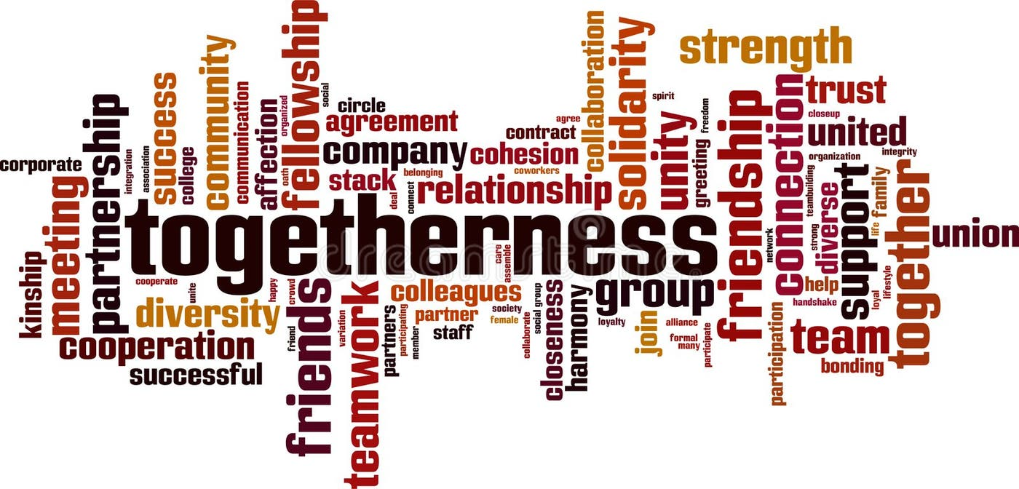
Fellowship
&
Community
For God so loved the world, he gave….

Slide 2
Fellowship
&
Community
Fellowship or community?
From and about HIM
To US
Isaiah 43

Slide 3
Fellowship
&
Community
You can have community without fellowship, but not fellowship without community

Slide 4
Fellowship
&
Community
What is fellowship? - in the New Testament, fellowship comes from the Greek word koinonia, and means a real, deeper and more intimate grouping of people, than just associating with and enjoying the company of other Christians.

Slide 5
Fellowship
&
Community
Genesis 1:26-27, - Then God said, “Let us make mankind in our image, in our likeness, so that they may rule over…” So God created mankind in his own image, in the image of God he created them; male and female he created them.

Slide 6
Fellowship
&
Community
We are meant to live in fellowship as God himself does.
Genesis 2:18;
The Lord God said, “It is not good for the man to be alone. I will make a helper suitable for him.”

Slide 7
Fellowship
&
Community
David Guzik: ‘For the first time, God saw something that was not good – the aloneness of humanity. God never intended for humanity to be alone... This is why he created a partner to suit him. A comparable, an equal helper to complete humanity.’

Slide 8
Fellowship
&
Community
‘Therefore, there is now no condemnation for those who are in Christ Jesus, ² because through Christ Jesus the law of the Spirit who gives life has set you free from the law of sin and death.’
So at the centre of our fellowship is HIM

Slide 9
Fellowship
&
Community
Matthew 28:18-20 ‘Then Jesus… said, ‘All authority in heaven and on earth has been given to me. ¹⁹ Therefore go and make disciples of all nations, baptising them in the name of the Father and of the Son and of the Holy Spirit, ²⁰ and teaching them to obey everything I have commanded you. And surely, I am with you always, to the very end of the age.’

Slide 10
Fellowship
&
Community
‘I know all this’, BUT… ‘go into all the world…’
are we seriously expecting something to happen?

Slide 11
Fellowship
&
Community
In the Independent on April 20, 2025, Helen Coffey recorded that ‘a new report suggests that the number of young churchgoers has quadrupled.’!!!!!

Slide 12
Fellowship
&
Community
In the USA, Pentecost 2025: This one-day initiative saw at least 26,657 individuals baptised and 6,445 salvations recorded across 1,080 baptism events hosted by 650 churches in all 50 states

Slide 13
Fellowship
&
Community
What about US? What about here? What about now?
Do you believe it?
Will you participate in it?
Are you preparing for it?
Are you seeking it?

Slide 14
Fellowship
&
Community
Encouragement from Isaiah
43:1-3a, 18-19, 44:1b-3a

Slide 15
Fellowship
&
Community
But now, this is what the Lord says he who created you, Jacob, he who formed you, Israel: “Do not fear, for I have redeemed you; I have summoned you by name; you are mine…

Slide 16
Fellowship
&
Community
When you pass through the waters, I will be with you; and when you pass through the rivers, they will not sweep over you. When you walk through the fire, you will not be burned; the flames will not set you ablaze. For I am the Lord your God, the Holy One of Israel, your Saviour;…

Slide 17
Fellowship
&
Community
“Forget the former things; do not dwell on the past. See, I am doing a new thing! Now it springs up; do you not perceive it? I am making a way in the wilderness and streams in the wasteland….

Slide 18
Fellowship
&
Community
“But now listen, Jacob, my servant, Israel, whom I have chosen. This is what the Lord says— he who made you, who formed you in the womb, and who will help you: Do not be afraid, Jacob, my servant, Jeshurun, whom I have chosen. For I will pour water on the thirsty land, and streams on the dry ground;

Slide 19
Fellowship
&
Community
Philippians 3:13b-14
‘…one thing I do: Forgetting what is behind and straining toward what is ahead, ¹⁴ I press on toward the goal to win the prize for which God has called me heavenward in Christ Jesus.’

Slide 20
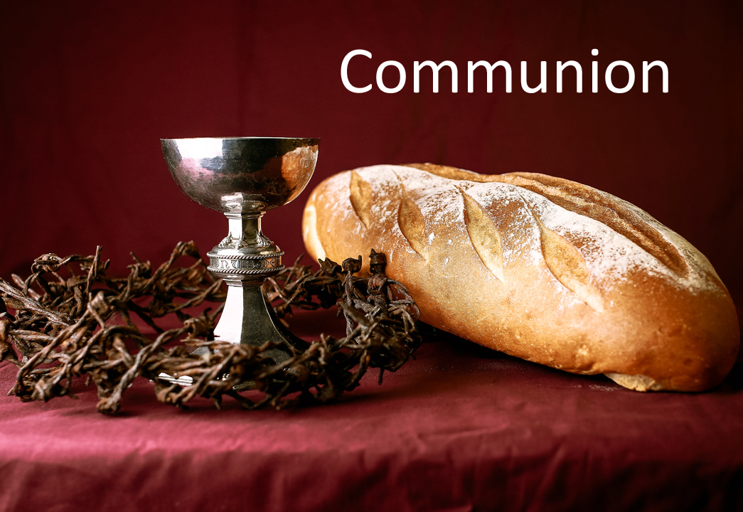

Slide 21
Welcome:
Contrition:
Commission:
Invitation:
Thanksgiving:

Slide 22


Slide 23
The Blessing
I pray that you may be strengthened in your inner being with power through the holy Spirit, and that Christ may dwell in your hearts through faith, as you are being rooted and grounded in love... (Eph 3:16-17)
Now to God who by the power at work within us, is able to accomplish abundantly far more than all we can ask or imagine, to God be glory in the church and in Christ Jesus to all generations forever and ever... (Eph 3:20-21)
The Lord bless you and keep you;
The Lord make his face to shine upon you and be gracious to you;
The Lord lift his countenance up on you and give you peace. (Num 6:24-26)

