Slide 2

God’s Banner of Love

Slide 3

God’s Banner of Love

Slide 4
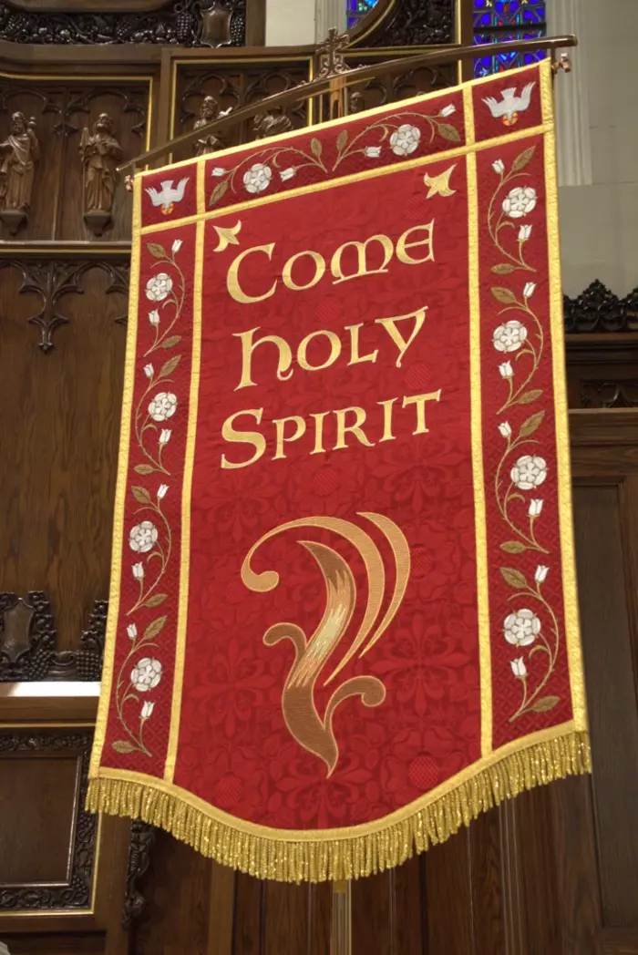

God’s Banner of Love

Slide 5

God’s Banner of Love

Slide 7
God’s Banner of Love
Question 1:
What ways does God shows His love?
Question 2:
How can you show God’s love this week?

Slide 9
God’s Banner of Love
“I am loved,
I belong,
and
God’s love goes with me.”

Slide 10
God’s Banner of Love
“You are loved,
You belong,
and
God’s love goes with You.”

