Slide 1

God’s healing

Slide 2
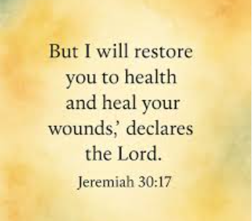

Slide 3


Slide 4


Slide 5


Slide 6


Slide 7
John 5 Verse 1 – 15
https://youtu.be/JMj1ggINLe4?si=h0JFa2EB5nzI90lX

Slide 8


Slide 9


Slide 10


