Slide 2
Connecting the Dots
❌ Not perfection
❌ Not power
❌ Not an easy life

Slide 3
Connecting the Dots
❌ Not perfection
❌ Not power
❌ Not an easy life
✅ Faith
✅ Courage
✅ Trust in God

Slide 4
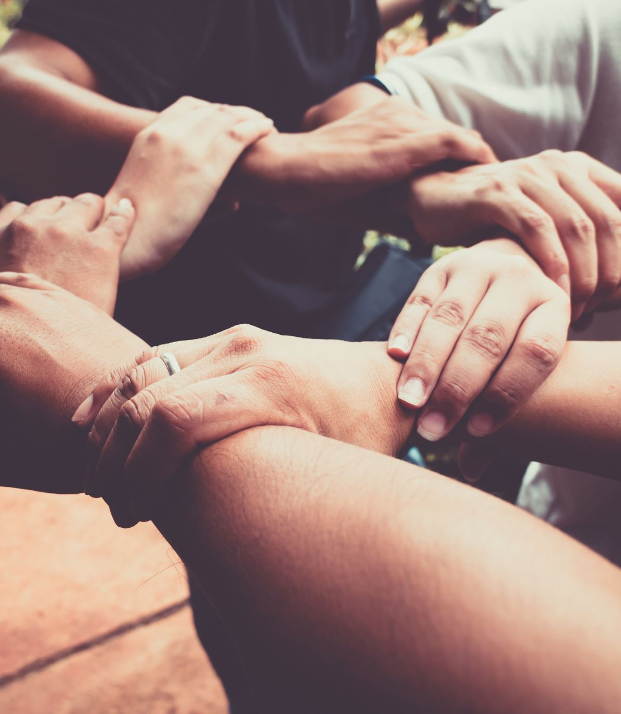
Weakness
→
Strength
(God’s way)

Slide 5
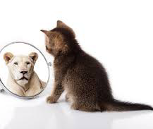
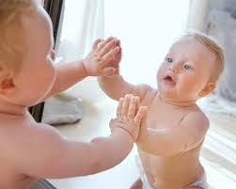
Could it be You?

