Slide 1
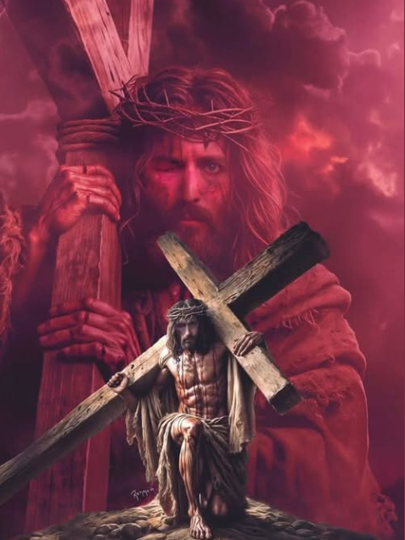
The Great Commission

Slide 2
Matthew 28:19-20
“All authority in heaven and on earth has been given to me. 19 Therefore go and make disciples of all nations, baptizing them in the name of the Father and of the Son and of the Holy Spirit, 20 and teaching them to obey everything I have commanded you. And surely I am with you always, to the very end of the age.”

Slide 3
God is with us always through His Spirit
John 14:26
But the Advocate, the Holy Spirit, whom the Father will send in my name, will teach you all things and will remind you of everything I have said to you.

Slide 4
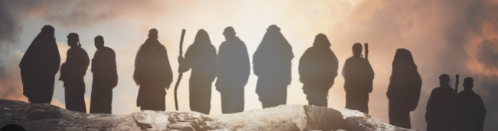
So how do we make Disciples ?

Slide 5
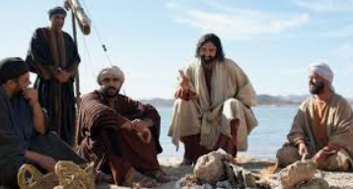
Modelling

Slide 6


Slide 7
So what are the relationships in your life like ?

Slide 8


