Slide 1

Kings Baptist Church
Living Life with Jesus
Luke 24: 36-52

Slide 2

Jesus appears to the disciples
While they were still talking about this, Jesus himself stood among them and said to them, ‘Peace be with you.’
They were startled and frightened, thinking they saw a ghost. He said to them, ‘Why are you troubled, and why do doubts rise in your minds? Look at my hands and my feet. It is I myself! Touch me and see; a ghost does not have flesh and bones, as you see I have.’
Luke 24: 36-39

Slide 3
When he had said this, he showed them his hands and feet. And while they still did not believe it because of joy and amazement, he asked them, ‘Do you have anything here to eat?’ They gave him a piece of broiled fish, and he took it and ate it in their presence.
He said to them, ‘This is what I told you while I was still with you: everything must be fulfilled that is written about me in the Law of Moses, the Prophets and the Psalms.’
Then he opened their minds so they could understand the Scriptures.
Luke 24: 40-45

Slide 4
He told them, ‘This is what is written: the Messiah will suffer and rise from the dead on the third day, and repentance for the forgiveness of sins will be preached in his name to all nations, beginning at Jerusalem. You are witnesses of these things. I am going to send you what my Father has promised; but stay in the city until you have been clothed with power from on high.’
Luke 24: 46-49

Slide 5
The ascension of Jesus
When he had led them out to the vicinity of Bethany, he lifted up his hands and blessed them. While he was blessing them, he left them and was taken up into heaven. Then they worshipped him and returned to Jerusalem with great joy.
Luke 24: 50-52

Slide 6


Slide 7
Living Life with Jesus
Luke 24: 36-52
Have you walked with me?
(the journey of experience)
2. Do you believe in me?
(the anchor of trust)
3. Are you responding to me?
(the mission of action)

Slide 8
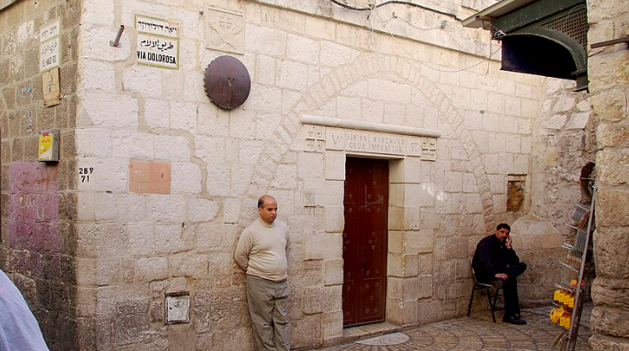
Living Life with Jesus
Luke 24: 36-52
Have you walked with Jesus?
(v 36-43)

Slide 9
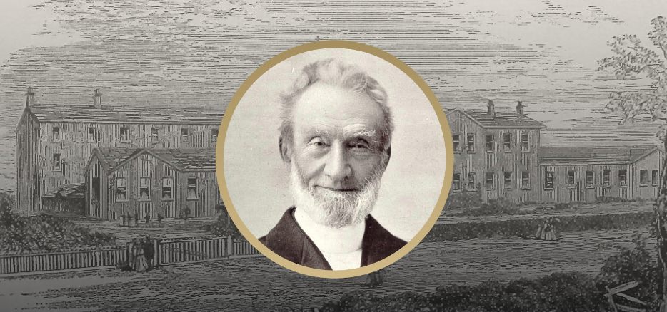
Living Life with Jesus
Luke 24: 36-52
2. Do you believe in Jesus?
(v 44-46)

Slide 10
Living Life with Jesus
Luke 24: 36-52
3. Are you responding to Jesus?
(v 47-53)

Slide 11
Living Life with Jesus
Luke 24: 36-52
Have you walked with Jesus?
(v 36-43)
2. Do you believe in Jesus?
(v 44-46)
3. Are you responding to Jesus?
(v 47-53)

