Slide 1

Jesus Saves!

Slide 2
Psalms 121 1- 8 I look up to the mountains from where does my help come from my help comes from the Lord who made heaven and earth.

Slide 3
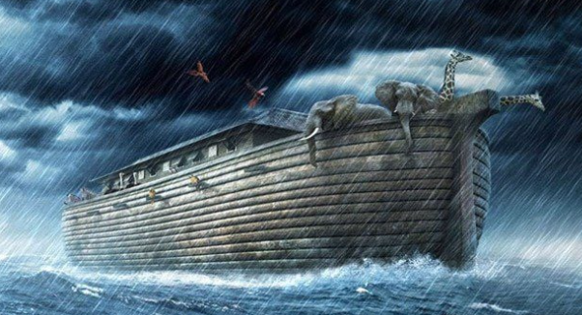
In the bible Noah took eight people with him on the ark to save humanity, modern science has now proved that there are eight major blood types in the world

Slide 4
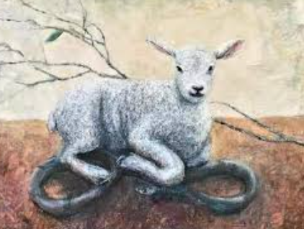
Satan was know as the serpent and Jesus was known as the lamb of God. Do you know that the only antivenom that can be used to completely neutralise the bite of snake is the blood of a lamb

Slide 5
Colossians 1:17
He is before all things and in him all things hold together -

Slide 6
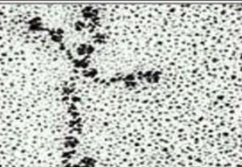
People think that skin holds us together – holding together all our organs but it is a protein molecule called laminin that is literary the glue that holds us together and if you look at it under a microscope it is the shape of a perfect cross.

Slide 7
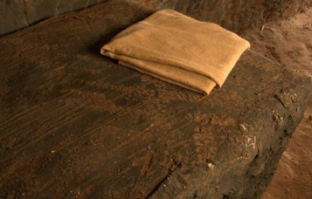
When Jesus died on the cross, when he rose from the dead he left behind the cloth that covered his face. It was folded on the stone where his body laid. Now in Jewish culture when the master was finished eating, he you would throw down his napkin, now if he was not finished he would fold it up because he was coming back. Now Jesus left a folded cloth, literally telling us he is not finished he is coming back!

Slide 8
(Luke 19:1-10)
Jesus was passing through Jericho. There was a chief tax collector there named Zacchaeus, who was rich. Zacchaeus was a little man, and wanted to see Jesus, so he climbed a sycamore tree. Jesus looked up and said, “Hurry down, Zacchaeus, because I must stay in your house today.” The people started grumbling because Jesus was going to the home of a sinner. However, Zacchaeus promised to give half his belongings to the poor and pay back four times as much to anyone he had cheated. Jesus concluded by saying “The Son of Man came to seek and to save the lost.

Slide 9
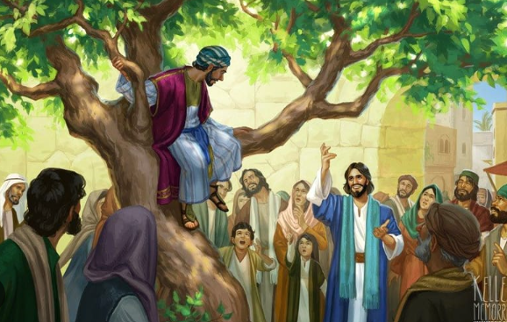
Zacchaeus

