Slide 1

Fathers’ Day
The Things We’ve Handed Down…

Slide 2
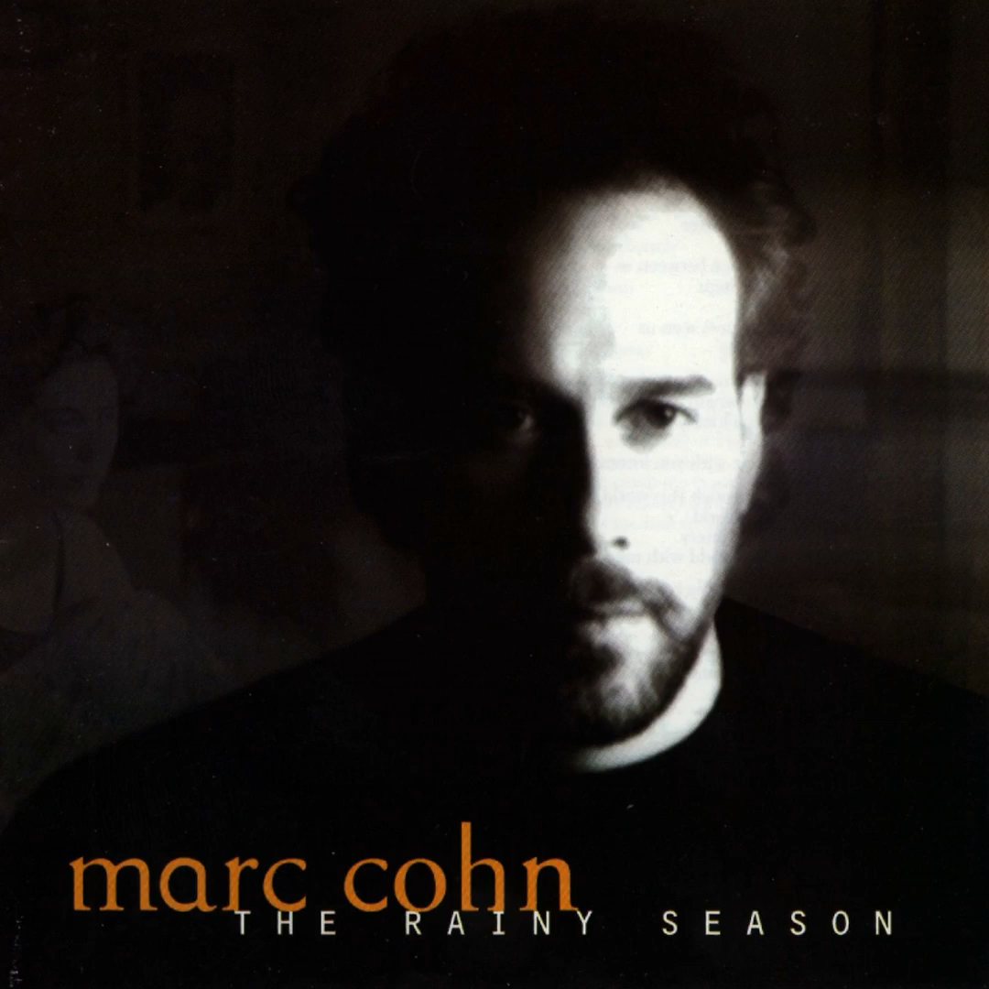
Mark Cohn- Things we’ve handed down https://youtu.be/qOHY6F_x2G0?si=daLNqvH6m9HFzpJ_

Slide 3
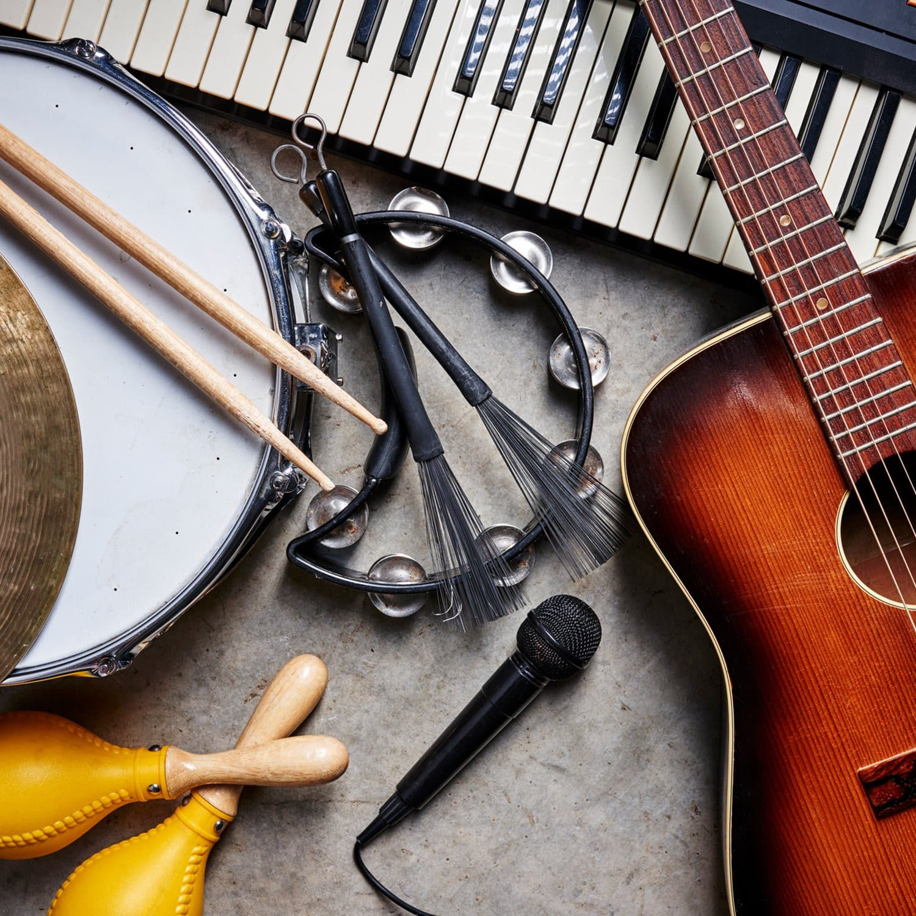

Slide 4
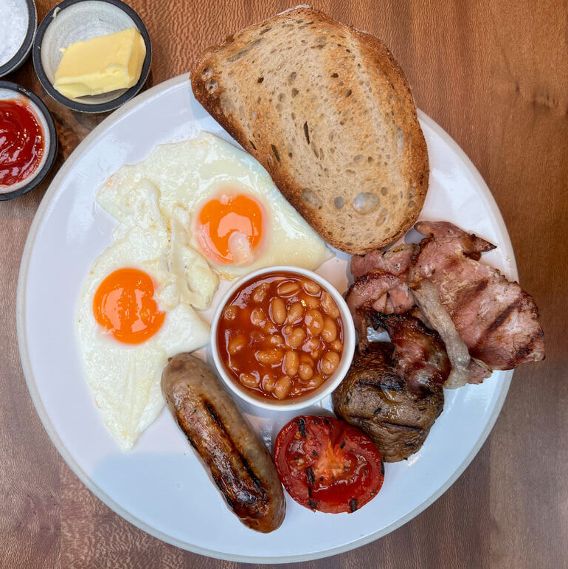

Slide 5


Slide 6
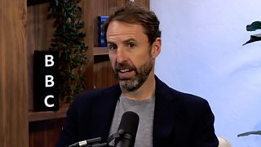

Slide 7
