Slide 1
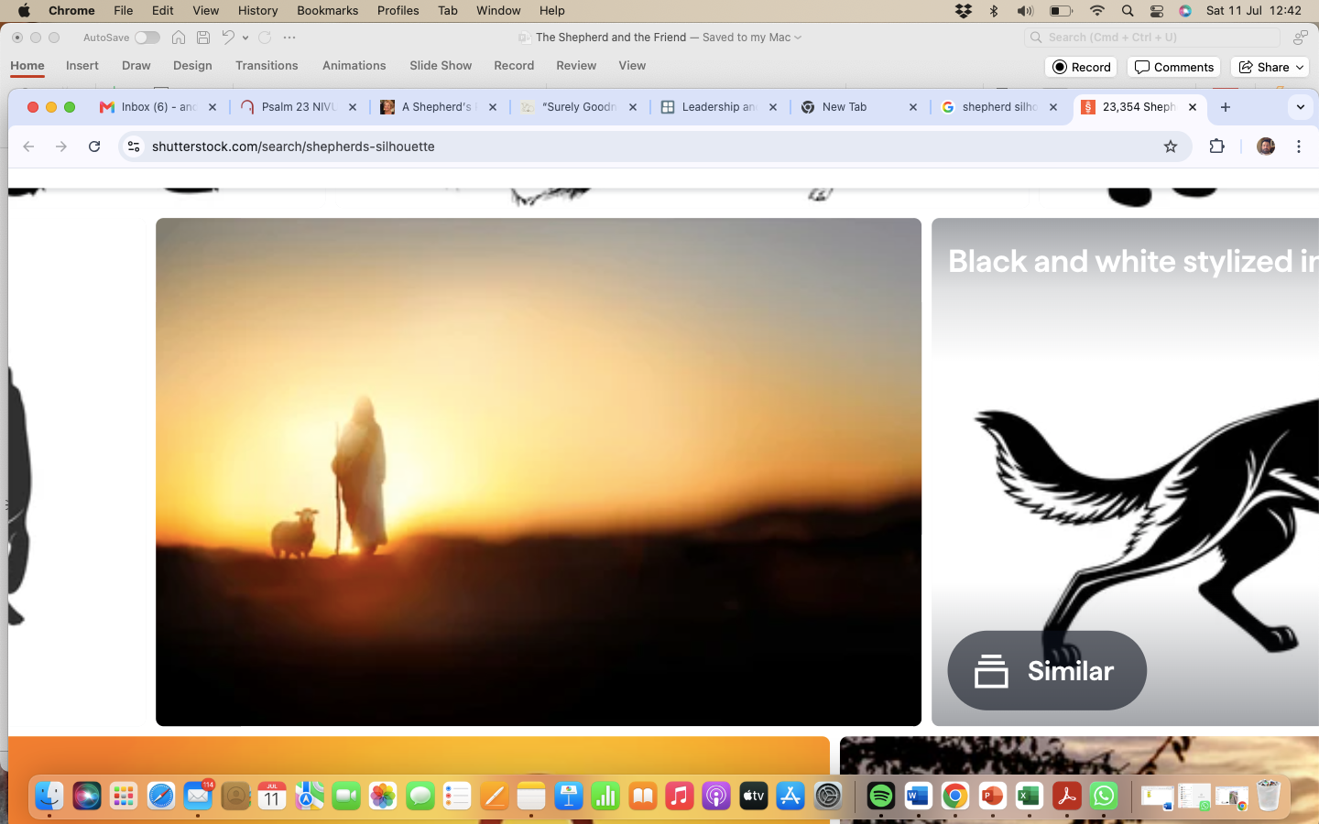
Psalm 23 – The Shepherd and the Friend

Slide 2
Psalm 23 – The Shepherd and the Friend
The Lord is my shepherd, I lack nothing.
He makes me lie down in green pastures,
he leads me beside quiet waters,
he refreshes my soul.

Slide 3
Psalm 23 – The Shepherd and the Friend
He guides me along the right paths
for his name’s sake.
Even though I walk
through the darkest valley,
I will fear no evil, for you are with me;
your rod and your staff, they comfort me.

Slide 4
Psalm 23 – The Shepherd and the Friend
You prepare a table before me
in the presence of my enemies.
You anoint my head with oil;
my cup overflows.

Slide 5
Psalm 23 – The Shepherd and the Friend
Surely your goodness and love will follow me
all the days of my life,
and I will dwell in the house of the Lord
for ever.

Slide 6
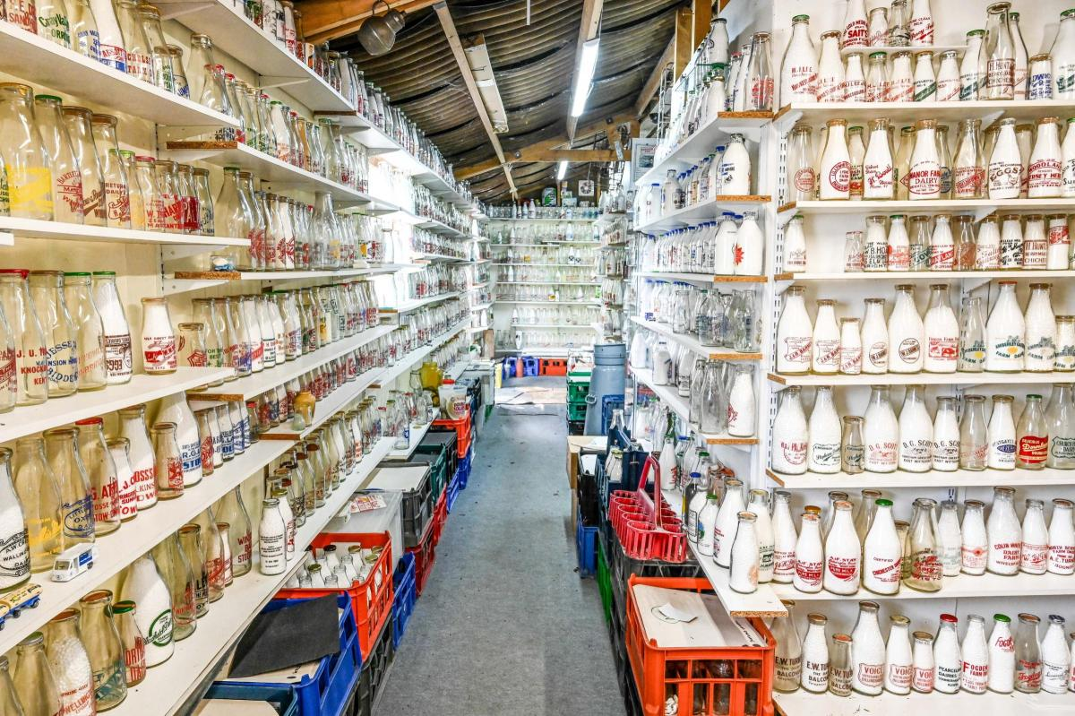

Slide 7
Psalm 23 – The Shepherd and the Friend
The Shepherd – v1-4

Slide 8
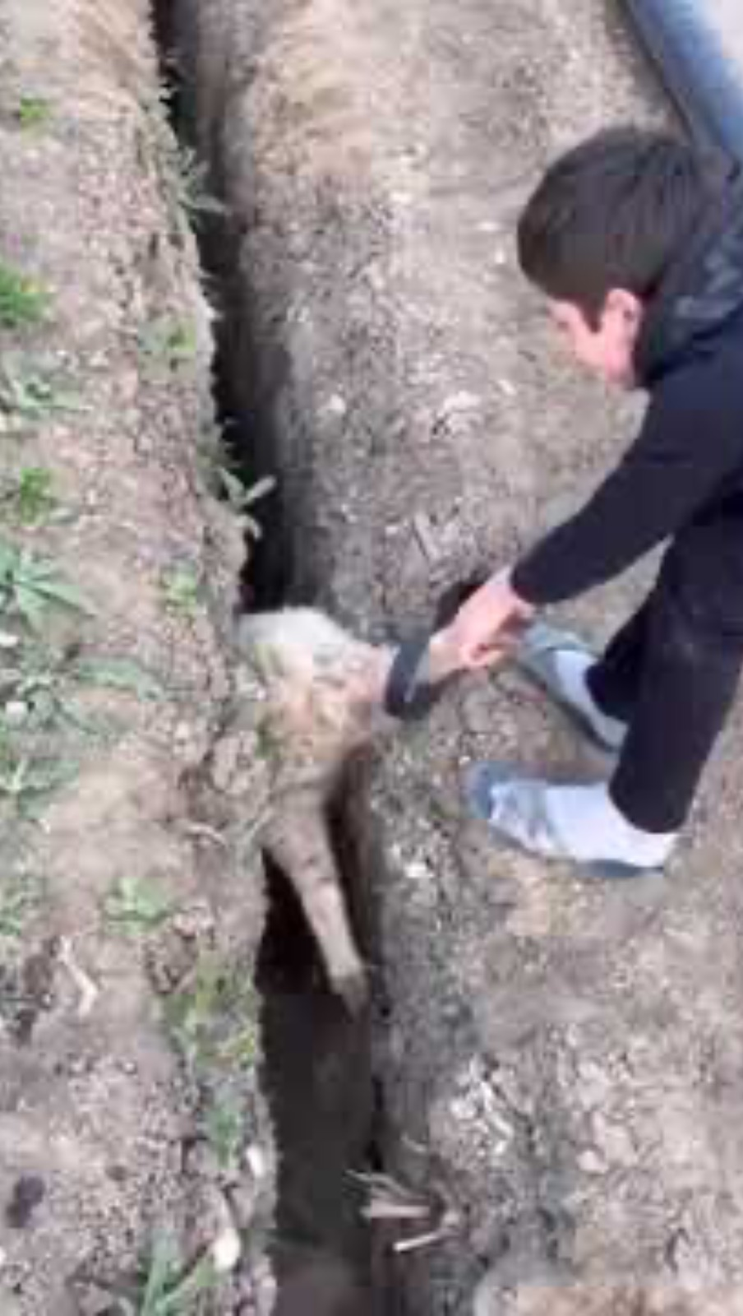

Slide 9
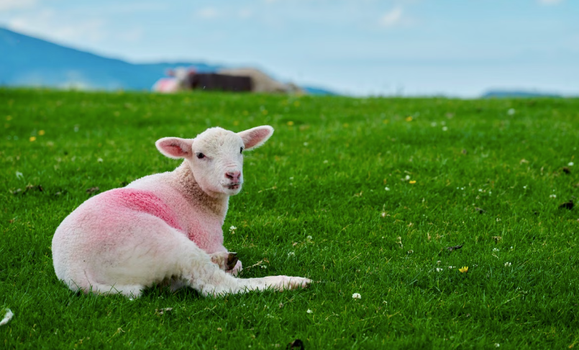
Psalm 23 – The Shepherd and the Friend
The Shepherd – v1-4

Slide 10

Psalm 23 – The Shepherd and the Friend
The Shepherd – v1-4
The Friend – v5-6

Slide 11
Psalm 23 – The Shepherd and the Friend
The Friend – v5-6
“Hope of eternity with Christ in heaven also enables my heart to thrive during the most difficult and lengthy of trials here on earth. When looking at the sheer weight of unseen glories to come, my troubles seem light by comparison; and when looking at the staggering length of eternity, my troubles seem fleeting by comparison. It is only against the backdrop of a glorious eternity that my circumstances can been seen in such a manner…”

Slide 12
Psalm 23 – The Shepherd and the Friend
The Shepherd – v1-4
The Friend – v5-6
God as your Shepherd
- Obsessively devoted - TODAY know and rest in his love
God as your Friend
- Passionately engaging – TODAY know he still chases after you

