Slide 1

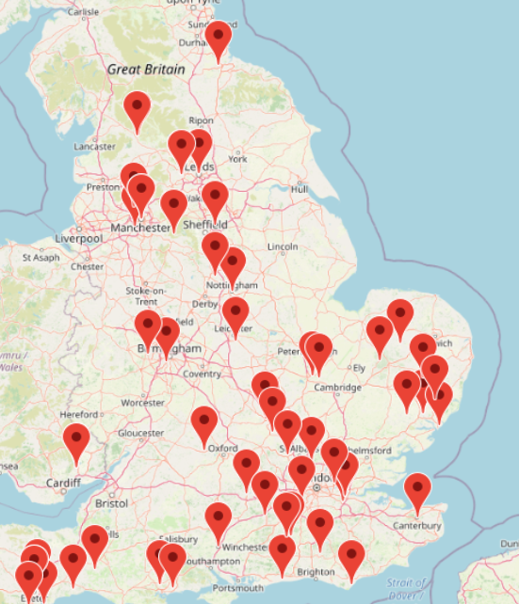
www.outreachuk.com

Slide 2
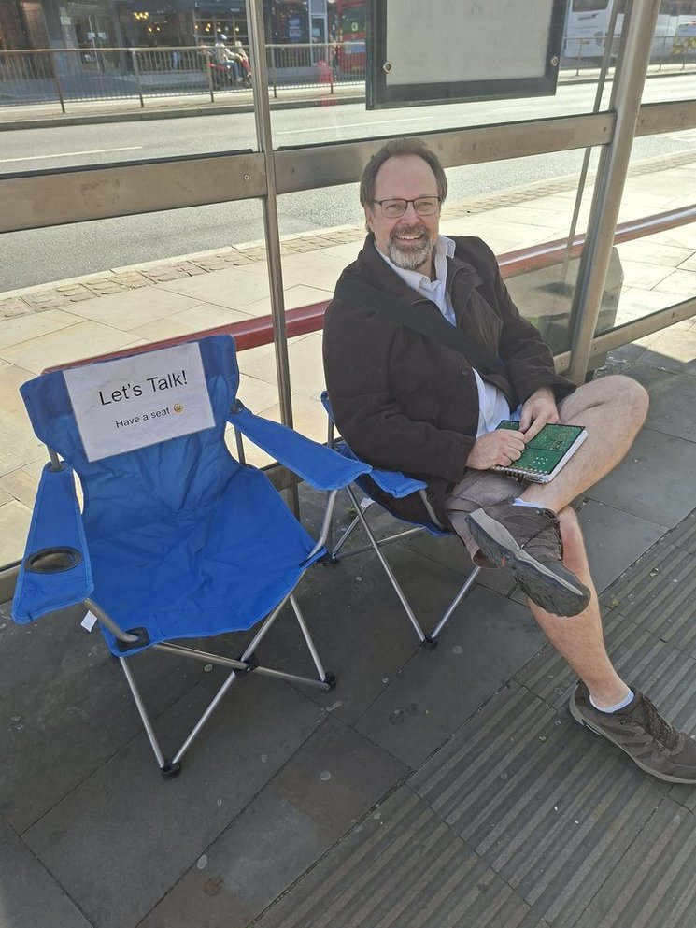
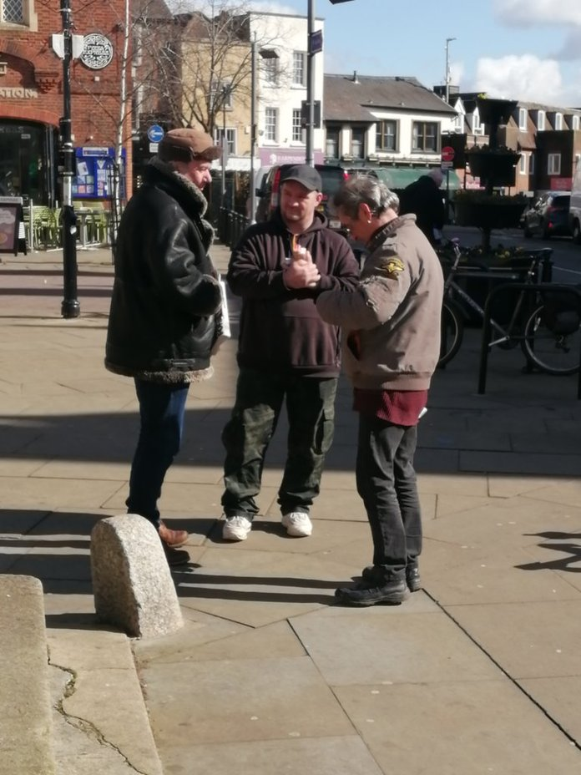
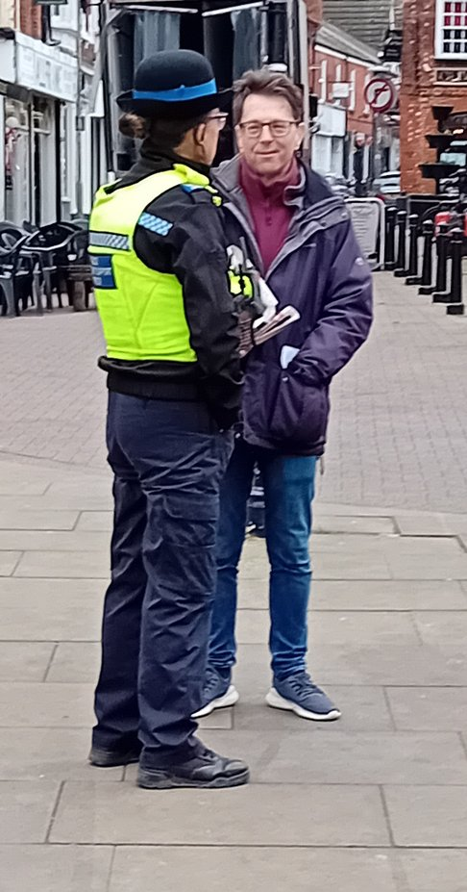
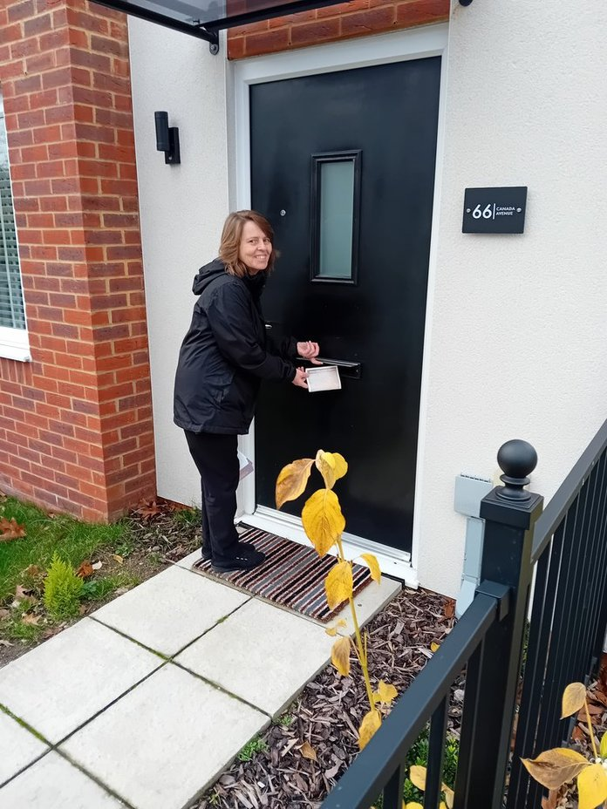
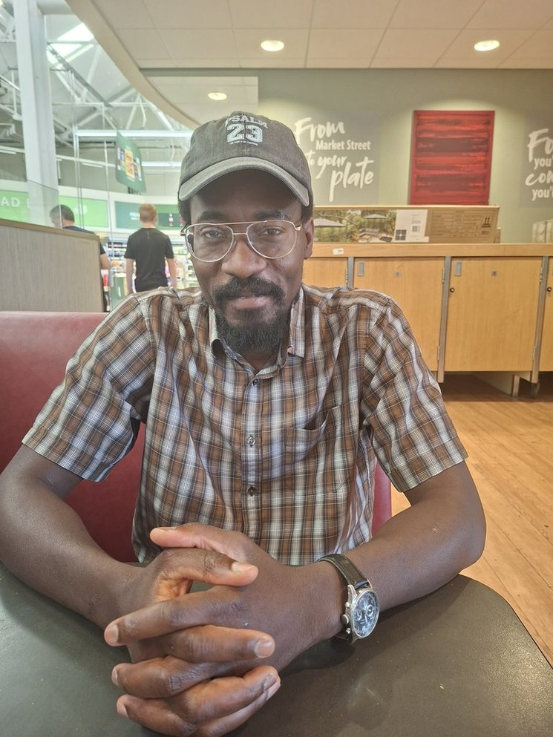

Slide 3
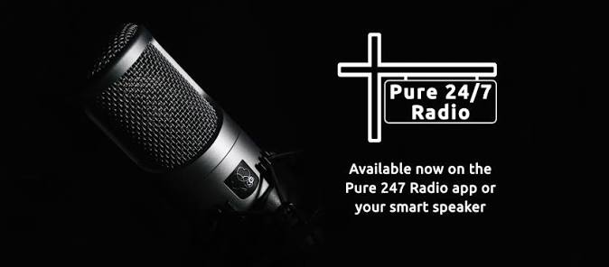
PLUS: I AM ON EVERY FRIDAY AT 5PM.

Slide 4
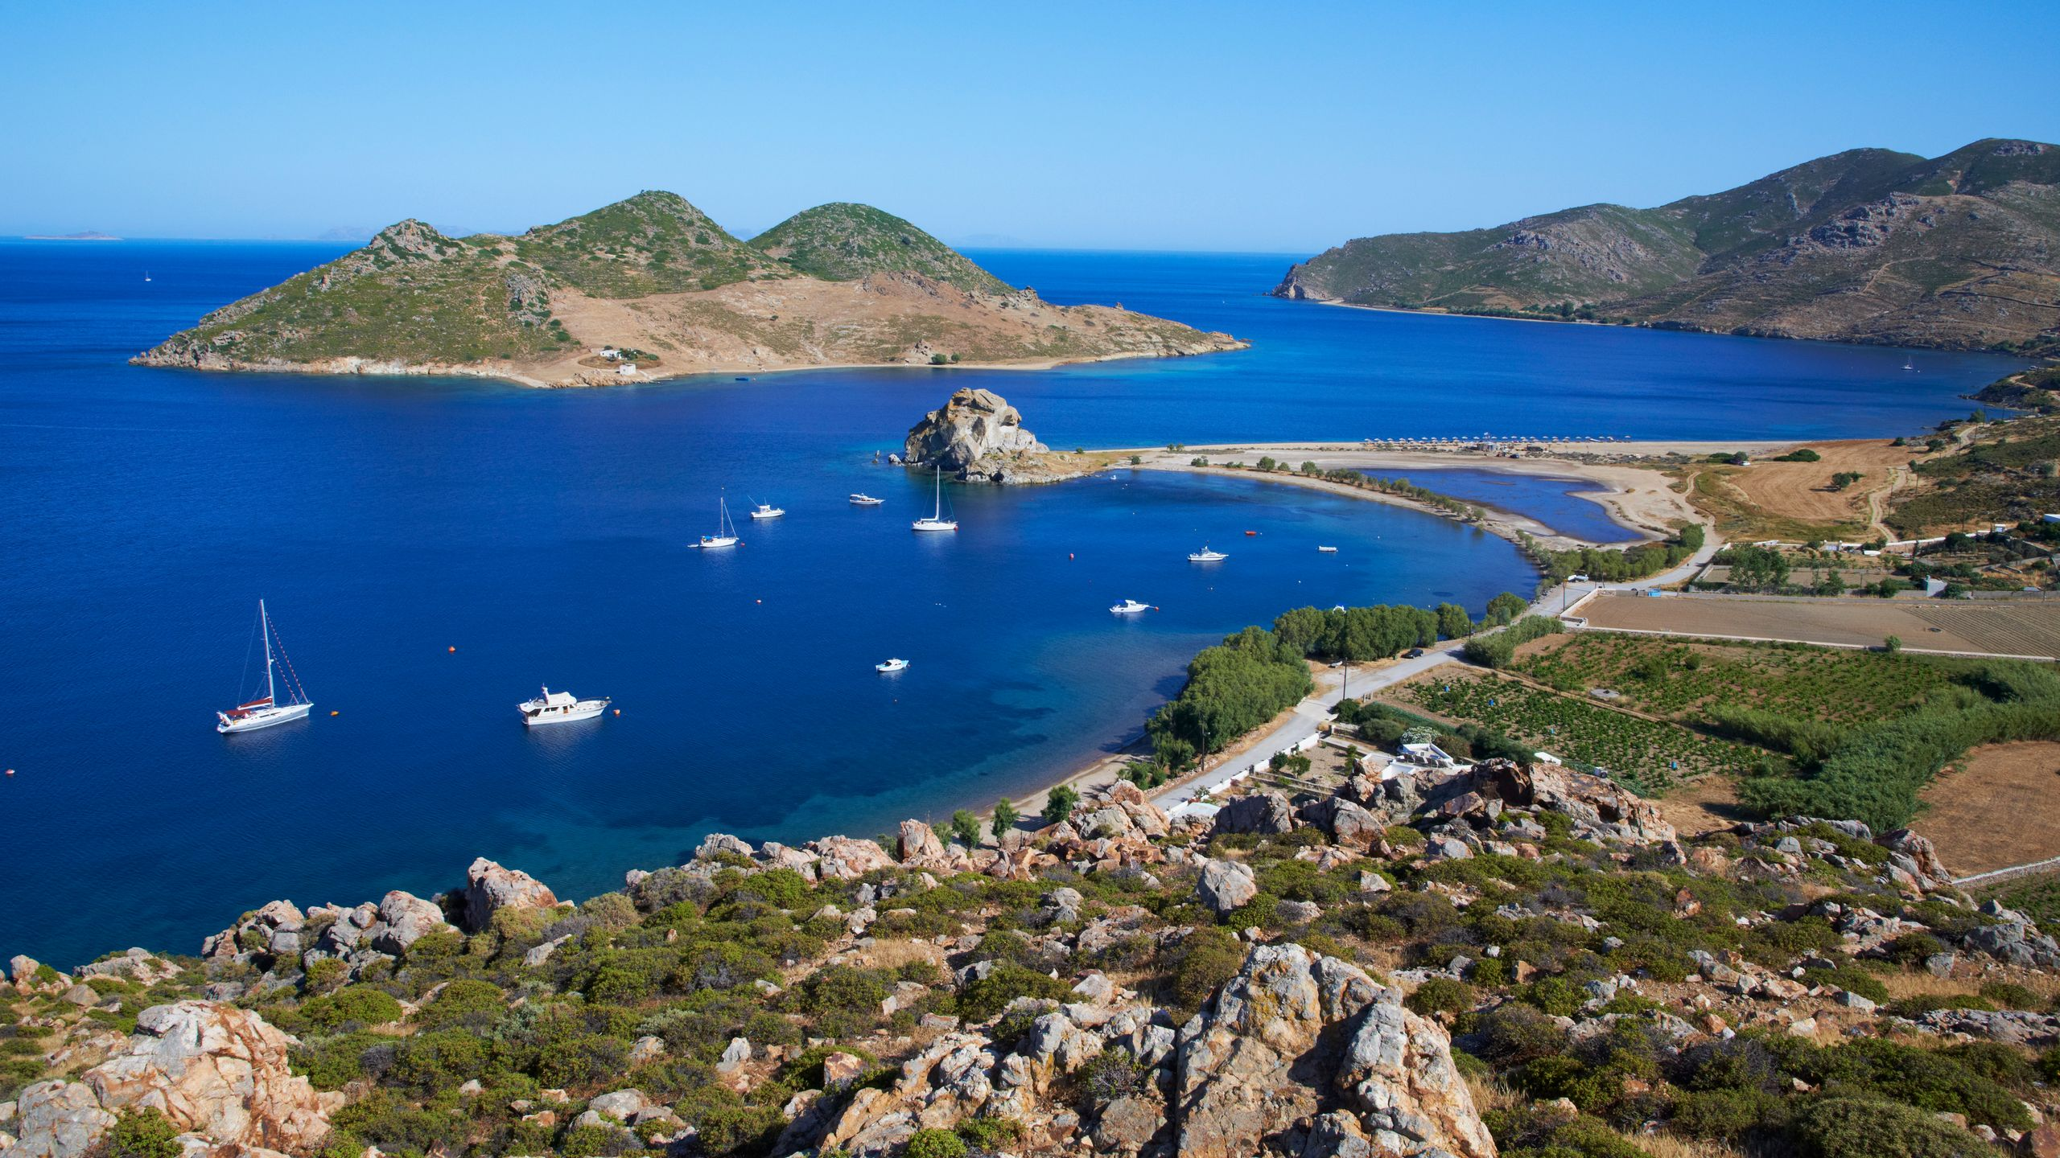
888888888888888888888888888888888888888888888888888888888888888888888888888888888888888888

Slide 5


Slide 6
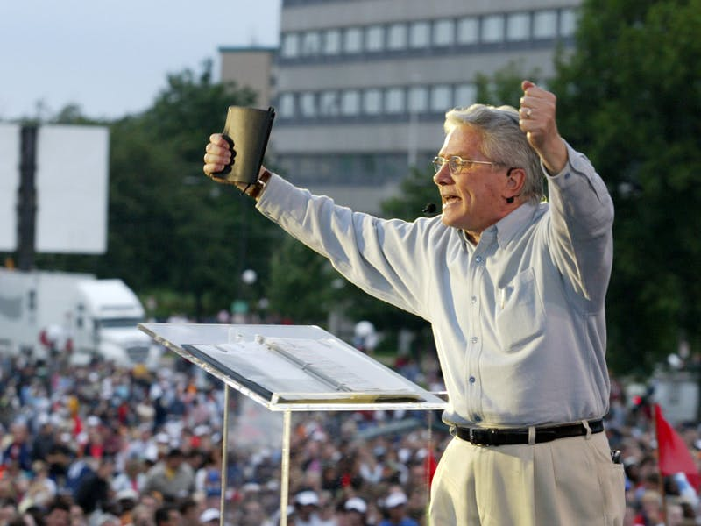
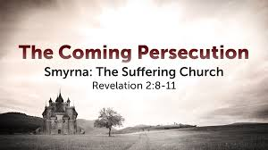
“BE FAITHFUL IN YOUR MINISTRY, BE FAITHFUL TO THE POINT OF DEATH!”

Slide 7
REVELATION 2 V 10:
¹⁰ Do not be afraid of what you are about to suffer. I tell you, the devil will put some of you in prison to test you, and you will suffer persecution for ten days. Be faithful, even to the point of death, and I will give you life as your victor’s crown.

Slide 8
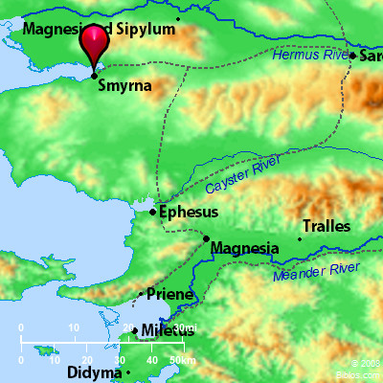
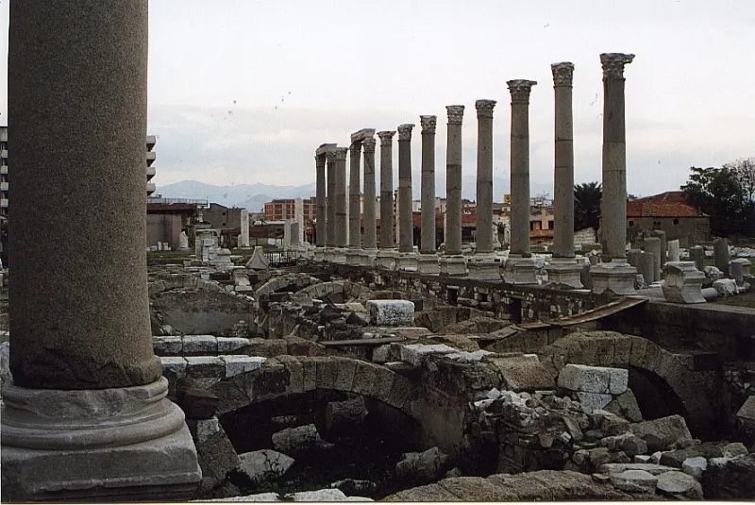
SMYRNA:
AN IMPORTANT COASTAL PORT.
VITAL FOR TRADE LINKS.
FULL OF BOTH ROMANS AND JEWS.
TODAY CALLED IZMIR.
THE FIRST CITY IN ASIA MINOR
TO ADOPT EMPEROR WORSHIP.

Slide 9
THE SYNAGOGUE OF SATAN.
SLANDER AND PERSECUTION BY THOSE WHO SHOULD KNOW BETTER.
LIKE SAUL BEFORE HE BECAME PAUL.
JESUS KNOWS WHAT IS GOING ON – AND –
IT’S GOING TO GET WORSE.
P.S. – NO ONE REALLY KNOWS WHAT THE REF TO 10 DAYS MEANS!

Slide 10

V 10 – “DO NOT BE AFRAID”
“DON’T BE AFRAID” OR VARIATIONS OF IT APPEAR 365 TIMES IN THE BIBLE.
EASIER SAID THAN DONE.
LOTS OF THINGS MAKE ME AFRAID – WORK, HEALTH, MONEY, RELATIONSHIPS, AND
PERSECUTION.
HOW IS IT POSSIBLE NOT TO BE AFRAID WHEN WE ARE ONLY HUMAN?

Slide 11

THE ANSWER IS TO LISTEN TO WHAT JESUS SAYS:
“THESE ARE THE WORDS OF THE FIRST AND THE LAST.”
THE ALPHA AND OMEGA.
THE BEGINNING AND THE END.
NEVER SLEEPING.

Slide 12
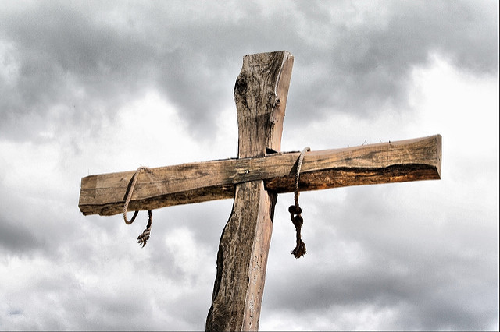
THE ANSWER IS TO LISTEN TO WHAT JESUS SAYS:
“WHO DIED”….
HE HAS SUFFERED AND UNDERSTANDS WHEN WE DO.

Slide 13
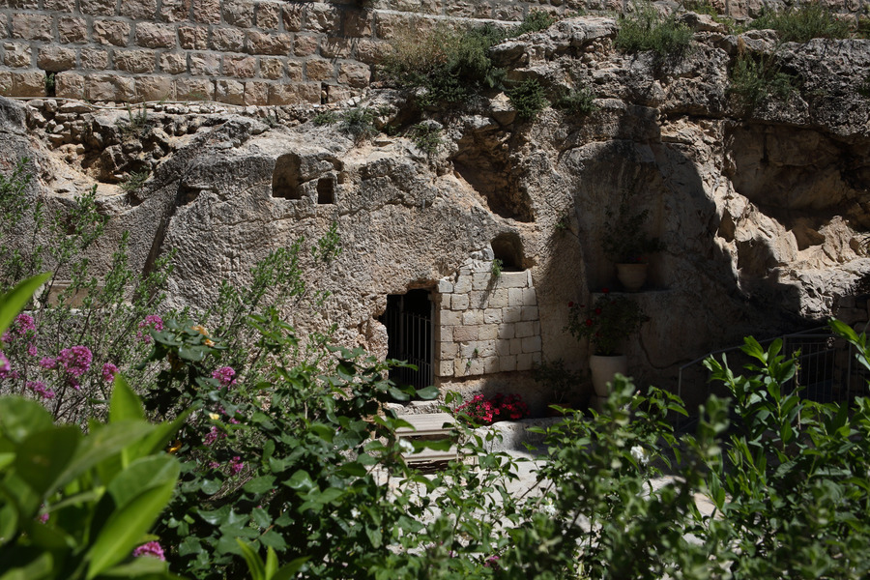
THE ANSWER IS TO LISTEN TO WHAT JESUS SAYS:
“AND CAME TO LIFE AGAIN”….
WITH US – EVERY DAY, ALL THE TIME.

Slide 14
THE ANSWER IS TO LISTEN TO WHAT JESUS SAYS:
“I KNOW YOUR AFFLICATIONS AND YOUR POVERTY”….
WITH US – EVERY DAY, ALL THE TIME.

Slide 15
THE ANSWER IS TO LISTEN TO WHAT JESUS SAYS:
“YOU ARE RICH”
LACKING NOTHING BECAUSE WE HAVE CHRIST.

Slide 16
“BE FAITHFUL IN YOUR MINISTRY, BE FAITHFUL TO THE POINT OF DEATH!”

Slide 17
ONLY ONE OF 2 LETTERS
TO THE 7 CHURCHES NOT TO CONTAIN CORRECTION, OR A REBUKE
SUFFERING PEOPLE NEED ENCOURAGEMENT.
WHOEVER HAS EARS LET HIM HEAR WHAT THE SPIRIT SAYS TO THE CHURCHES. THE ONE WHO IS VICTORIOUS WILL NOT BE HURT BY THE SECOND DEATH. (Hell, judgement)
PRAISE GOD!

