Slide 1

New Isaiah
Beginnings 43: 16-21

Slide 2
This is what the Lord says:
he who made a way through the sea,
a path through
the mighty waters,
who drew out the chariots and horses,
the army and reinforcements together,
and they lay there, never to rise again,
extinguished, snuffed out like a wick:
New Isaiah
Beginnings 43: 16-21
Notes:
Bible Passage

Slide 3
‘Forget the
former things;
do not dwell
on the past.
See, I am doing a new thing!
Now it springs up; do you not perceive it?
I am making a way in the wilderness
and streams in the wasteland.
New Isaiah
Beginnings 43: 16-21

Slide 4
The wild animals
honour me,
the jackals
and the owls,
because I provide water in the wilderness
and streams in the wasteland,
to give drink to my people, my chosen,
the people I formed for myself
that they may proclaim my praise.
New Isaiah
Beginnings 43: 16-21

Slide 5
New Isaiah
Beginnings 43: 16-21
Notes:
Introduction

Slide 6
God can make a way
v16-17
Embrace tomorrow
v18-19
Expect God
v19-21
New Isaiah
Beginnings 43: 16-21

Slide 7
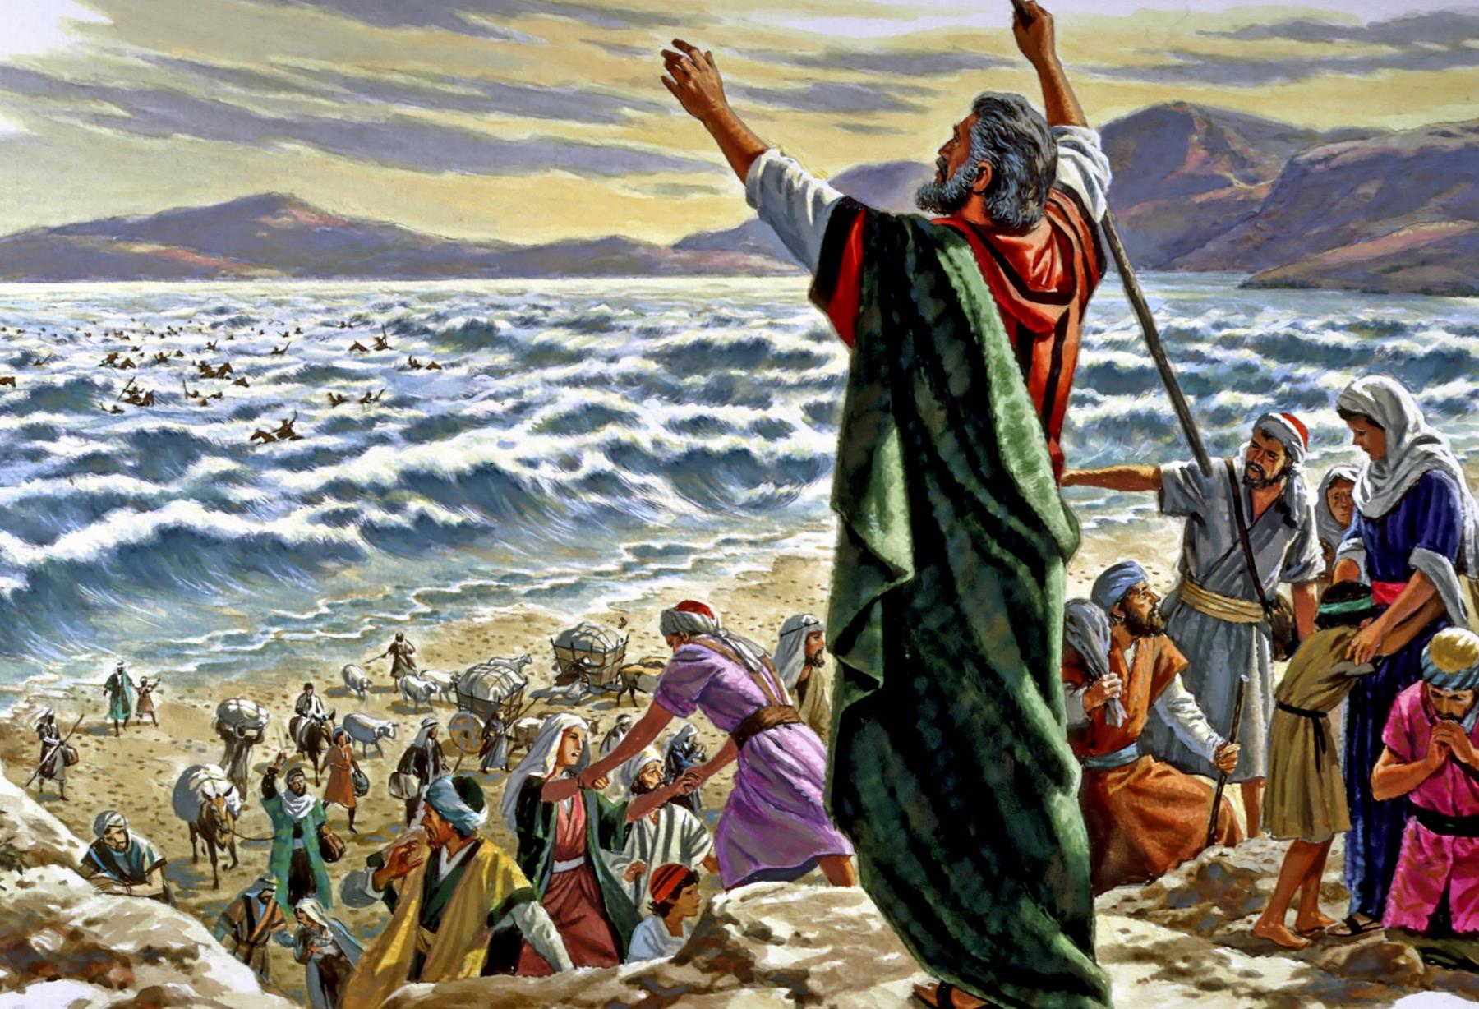
God can make a way
v16-17
New Isaiah
Beginnings 43: 16-21

Slide 8
God can make a way
v16-17
Do we believe and trust in the same God who parted the Red Sea?
New Isaiah
Beginnings 43: 16-21

Slide 9
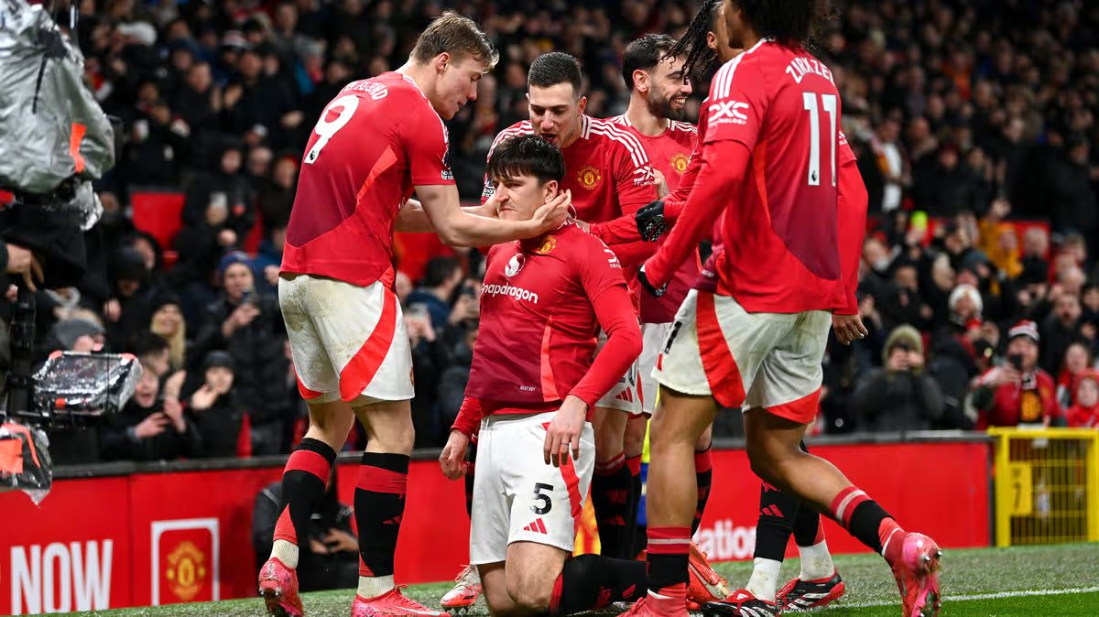
Embrace tomorrow
v18-19
New Isaiah
Beginnings 43: 16-21

Slide 10
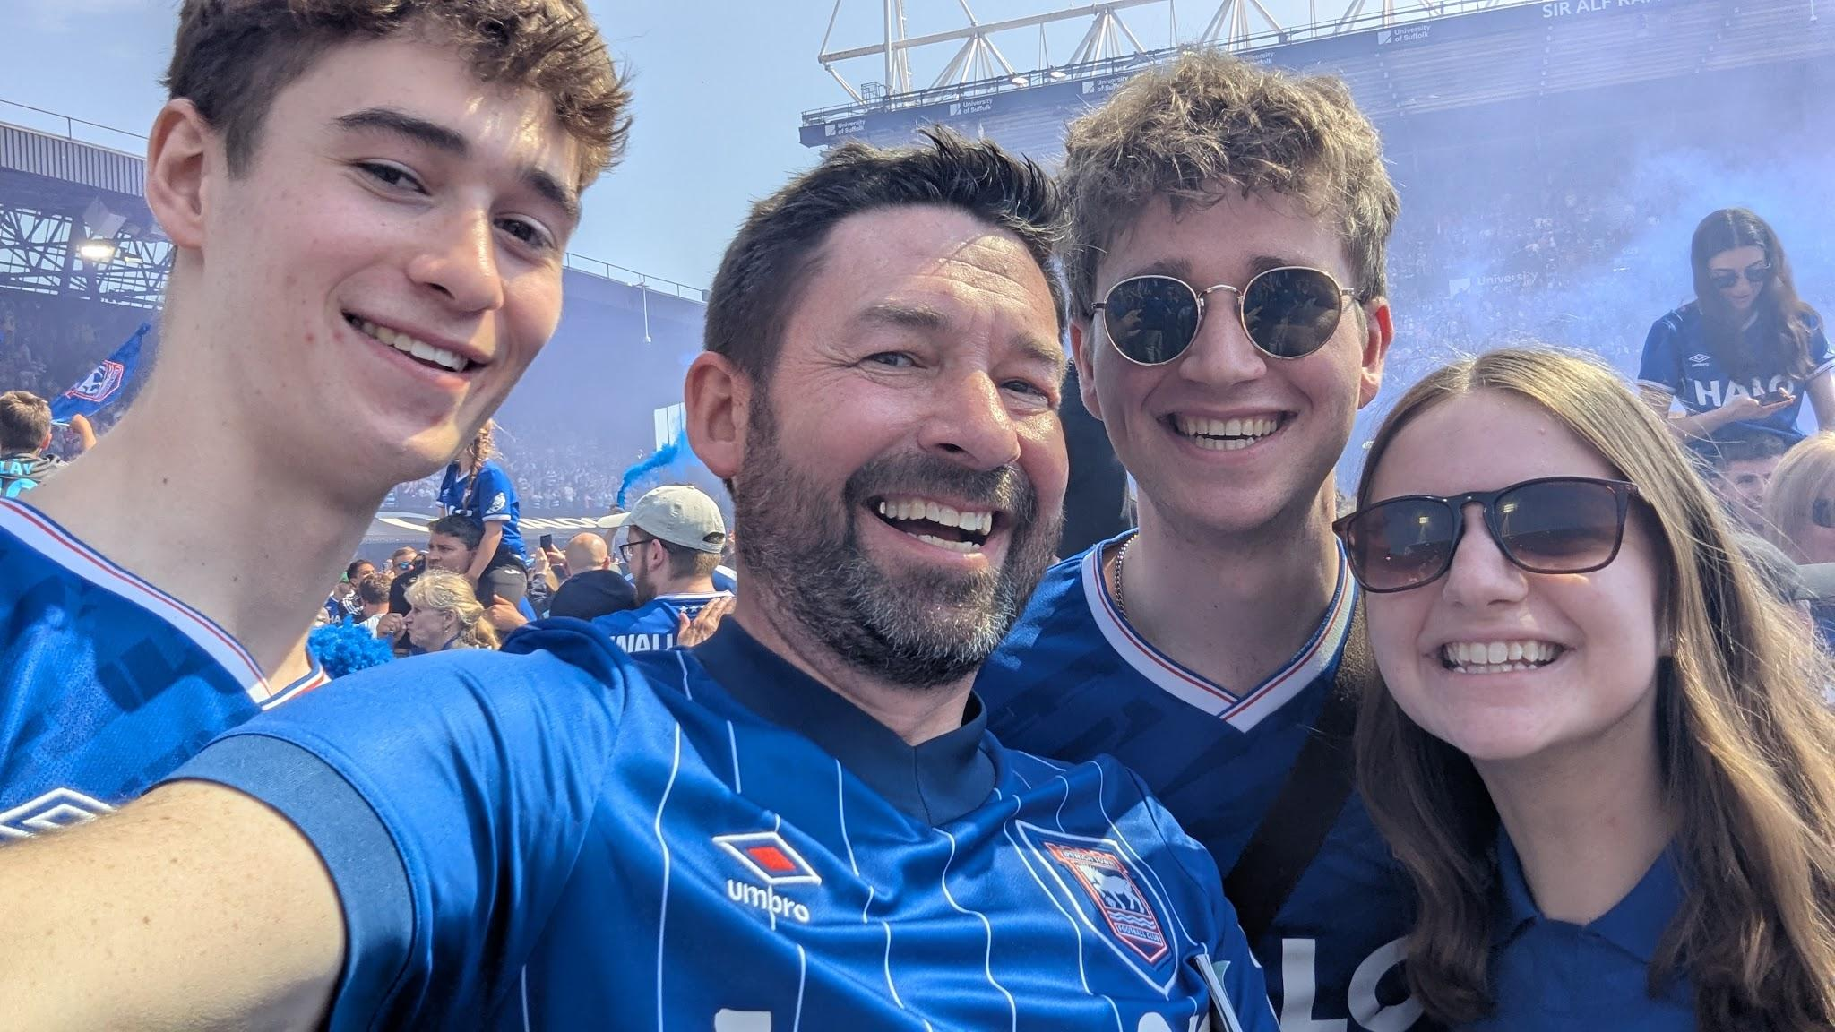
Embrace tomorrow
v18-19
New Isaiah
Beginnings 43: 16-21

Slide 11

Week of Prayer
Monday 7th at 7pm
Tuesday 8th at 7pm
Wednesday 9th at 10am
Thursday 10th at 7pm
Friday 11th 7pm (Pizza and Prayer)
Embrace tomorrow
v18-19
New Isaiah
Beginnings 43: 16-21

Slide 12
Expect God
v19-21
New Isaiah
Beginnings 43: 16-21

Slide 13
Expect God
v19-21
“See, I am doing a new thing!”
God made a way
New Isaiah
Beginnings 43: 16-21

Slide 14
God can make a way
v16-17
Embrace tomorrow
v18-19
Expect God
v19-21
“What is God doing,
And how can I join Him?”
New Isaiah
Beginnings 43: 16-21

Slide 15
New Isaiah
Beginnings 43: 16-21

