Slide 1


Simple Prayer
Matthew 6: 5-13

Slide 2
‘And when you pray, do not be like the hypocrites, for they love to pray standing in the synagogues and on the street corners to be seen by others. Truly I tell you, they have received their reward in
full. But when you pray, go into your room,
close the door and pray to your Father, who is unseen. Then your Father, who sees what is
done in secret, will reward you.
Simple Prayer
Matthew 6: 5-13

Slide 3
And when you pray, do not keep on babbling like pagans, for they think they will be heard because of their many words. Do not be like them, for your Father knows what you need before you ask him.
‘This, then, is how you should pray:
‘“Our Father in heaven,
hallowed be your name,
Simple Prayer
Matthew 6: 5-13

Slide 4
your kingdom come,
your will be done,
on earth as it is in heaven.
Give us today our daily bread.
And forgive us our debts,
as we also have forgiven our debtors.
And lead us not into temptation,
but deliver us from the evil one.
Simple Prayer
Matthew 6: 5-13

Slide 5
Simple Prayer
Matthew 6: 5-13

Slide 6
Humble Prayers
Secret Prayers
Short Prayers
Persistent Prayers
Silent Prayers
Simple Prayer
Matthew 6: 5-13

Slide 7
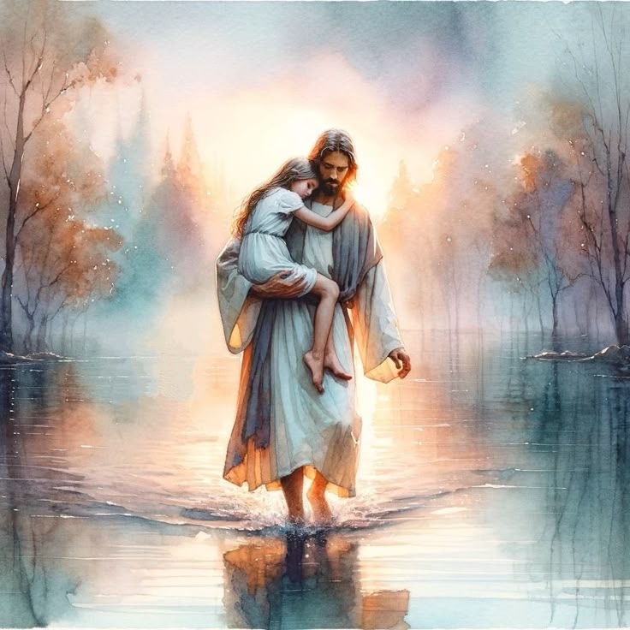
Humble Prayers
Climbing into the lap
of my heavenly Father
Simple Prayer
Matthew 6: 5-13

Slide 8
Humble Prayers
Begin with Worship
Open your Arms
Confess Honestly
Surrender the Agenda
Simple Prayer
Matthew 6: 5-13

Slide 9

Secret Prayers
‘When you pray,
go into your room,
close the door’
Simple Prayer
Matthew 6: 5-13

Slide 10
Secret Prayers
Find the Place
Set the Time
Be Real
Simple Prayer
Matthew 6: 5-13

Slide 11
‘And when you pray,
do not keep on babbling’
God knows what we need
Short Prayers
Simple Prayer
Matthew 6: 5-13

Slide 12
‘And when you pray,
do not keep on babbling’
God knows what we need
Short Prayers
Use your Bible
One line prayers
Pray the name of Jesus
Simple Prayer
Matthew 6: 5-13

Slide 13
The LORD’s Prayer
Persistent Prayers
Simple Prayer
Matthew 6: 5-13

Slide 14
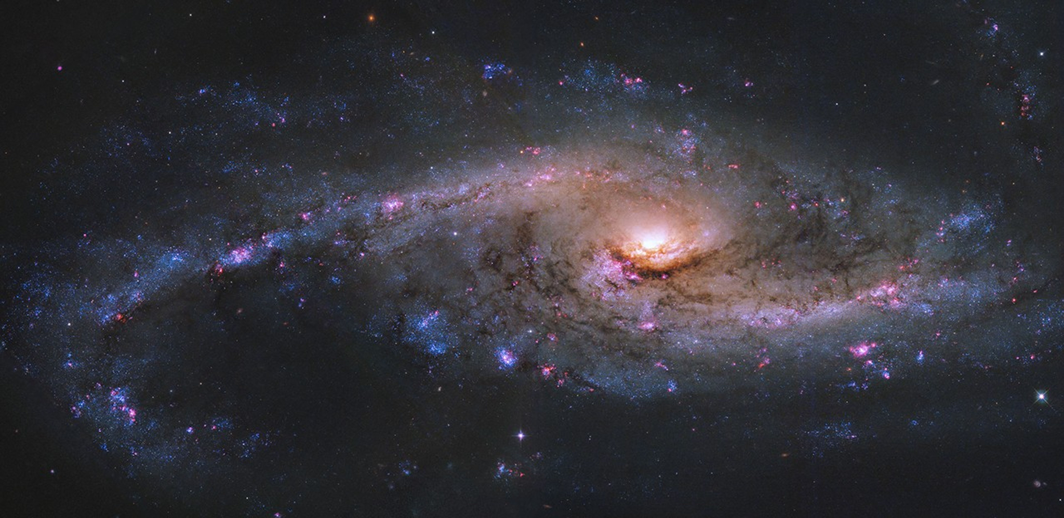
Silent Prayers
Simple Prayer
Matthew 6: 5-13

Slide 15
Find Quiet Spaces
Set a short time (2-5mins)
Focus on God - “Here I am LORD”
Let Thoughts Pass
Silent Prayers
Simple Prayer
Matthew 6: 5-13

Slide 16
Humble Prayers
Secret Prayers
Short Prayers
Persistent Prayers
Silent Prayers
Simple Prayer
Matthew 6: 5-13

