Slide 1


Slide 2
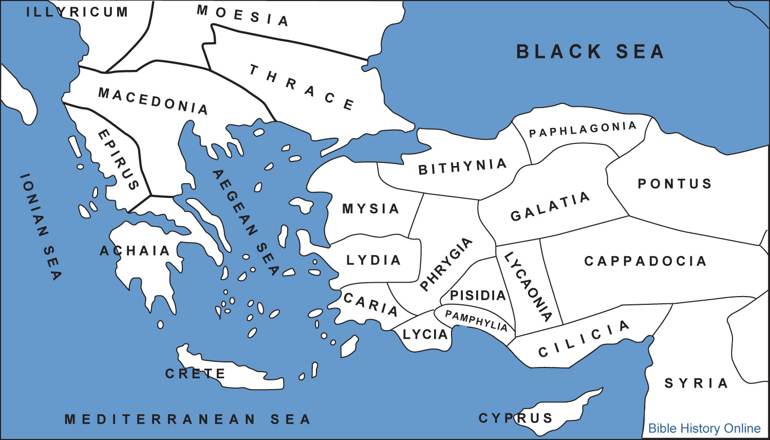

Slide 3
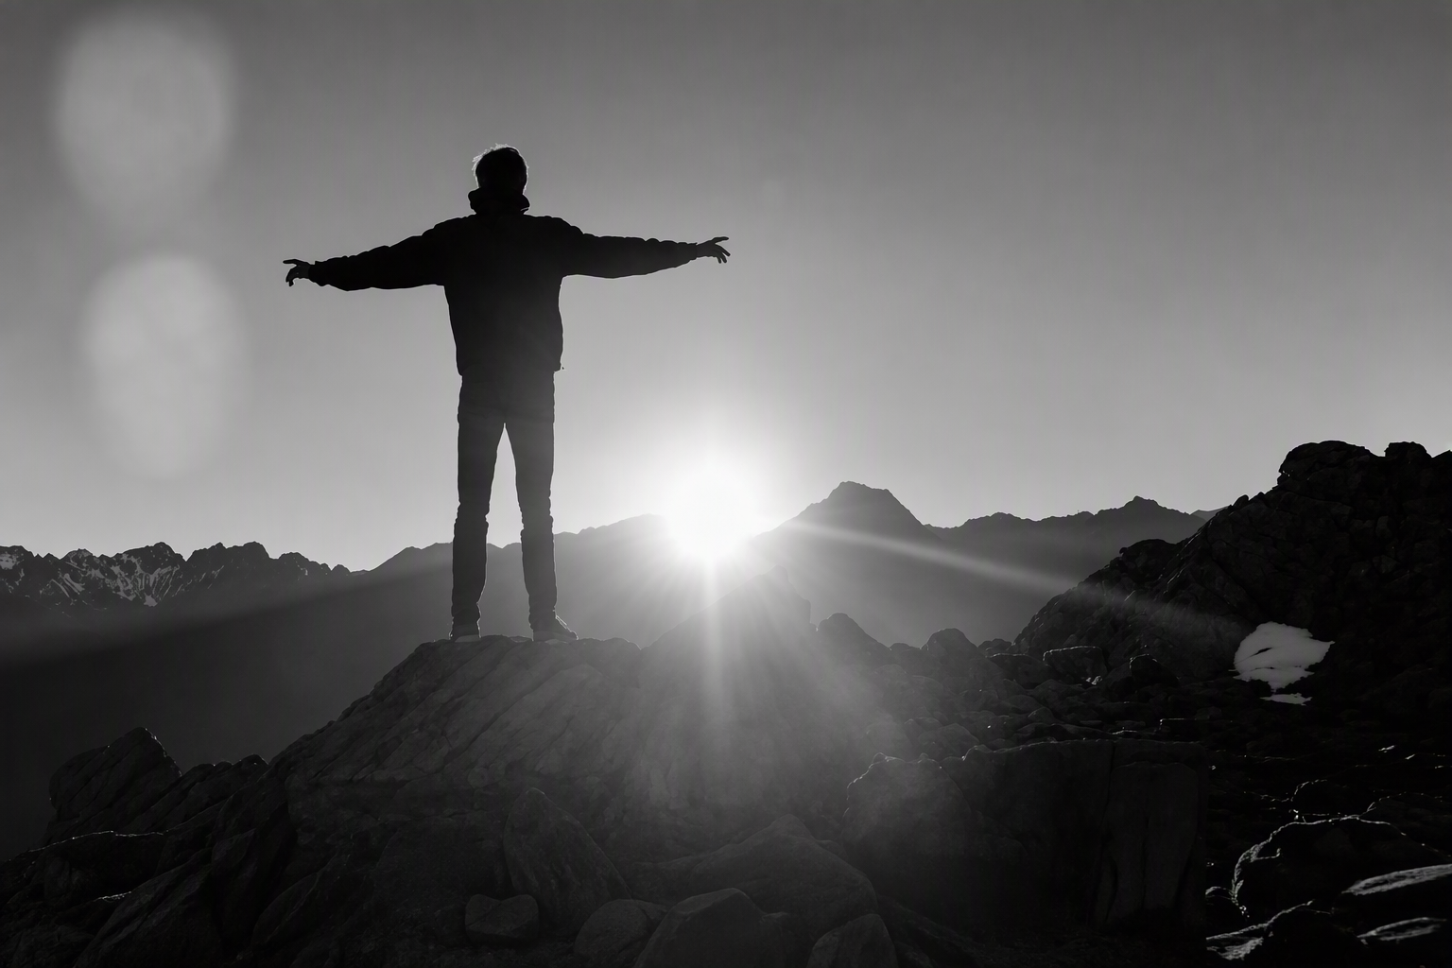


Slide 4


Slide 5
Peter, an apostle of Jesus Christ,
To God’s elect, exiles, scattered throughout the provinces of Pontus, Galatia, Cappadocia, Asia and Bithynia, who have been chosen according to the foreknowledge of God the Father, through the sanctifying work of the Spirit, to be obedient to Jesus Christ and sprinkled with his blood:
Grace and peace be yours in abundance.

Slide 6
Praise to God for a living hope
Praise be to the God and Father of our Lord Jesus Christ! In his great mercy he has given us new birth into a living hope through the resurrection of Jesus Christ from the dead, and into an inheritance that can never perish, spoil or fade. This inheritance is kept in heaven for you, who through faith are shielded by God’s power until the coming of the salvation that is ready to be revealed in the last time. In all this you greatly rejoice, though now for a little while you may have had to suffer grief in all kinds of trials.

Slide 7
These have come so that the proven genuineness of your faith – of greater worth than gold, which perishes even though refined by fire – may result in praise, glory and honour when Jesus Christ is revealed. Though you have not seen him, you love him; and even though you do not see him now, you believe in him and are filled with an inexpressible and glorious joy, for you are receiving the end result of your faith, the salvation of your souls.

Slide 8
Concerning this salvation, the prophets, who spoke of the grace that was to come to you, searched intently and with the greatest care, trying to find out the time and circumstances to which the Spirit of Christ in them was pointing when he predicted the sufferings of the Messiah and the glories that would follow.

Slide 9
It was revealed to them that they were not serving themselves but you, when they spoke of the things that have now been told you by those who have preached the gospel to you by the Holy Spirit sent from heaven. Even angels long to look into these things.

Slide 10
1. Peter Speaks Positively About Eternity (Verses 3–5)

Slide 11
1. Peter Speaks Positively About Eternity (Verses 3–5)

Slide 12

2. Peter Gives Praise to God for the Present (Verses 6–9)

Slide 13
3. Peter Reminds Us of the Prophets of the Past (Verses 10–12)

Slide 14
One takeaway from this morning:
Positive for the Future
Praise for Today
Grateful for the Past
1. Peter Speaks Positively About Eternity (Verses 3–5)
2. Peter Gives Praise to God for the Present (Verses 6–9)
3. Peter Reminds Us of the Prophets of the Past (Verses 10–12)

